Slide 1


Practice Assessor Preparation
To provide registered nurses and midwives with support and guidance as they continue their journey with supporting students and develop as Practice Assessors within NHS Lothian
Notes:
This presentation has been developed by the Practice Education Facilitators in NHS Lothian to support and enhance the preparation of registered nurses and midwives on their journey to prepare to become a Practice Assessor. We hope you find it a useful guide as you take the next step bto becoming a practice assessor.

Slide 2

Your Journey This Far
As a registered nurse or midwife, you will have successfully completed the preparation work to become a practice supervisor
You will hopefully have had some time to provide support and supervision to student nurses and midwives as a practice supervisor and will have adequate experience in doing this
You are now ready to undertake the necessary preparation work to become a practice assessor
In some clinical areas, where there is a greater need for practice assessors, you may be doing practice supervision and assessment almost simultaneously
Good luck on this next part of your journey!!
Notes:
In preparation for taking on the role of practice assessor it is recommended that you complete the NES elearning units on practice supervision and assessment if you have not yet had the opportunity to do them. There is also the expectation that you will have attended the NHS Lothian practice supervisor workshop or carried out equivalent learning and that you will have some experience of supporting students as a PS in the practice learning environment.

Slide 3
Part 2 Standards for Student Supervision and Assessment (NMC 2018)
Assessment of Students and Confirmation of proficiency
6.3 ‘Nursing students are assigned to practice and academic assessors who are registered nurses with appropriate equivalent experience for the student’s field of practice’
6.4 Midwifery students are assigned to practice and academic assessors who are registered midwives
6.5 Specialist Community Public Health Nurses ( SCPHN) are assigned to practice and academic assessors who are registered practitioners who are also SCPHNs
Notes:
Clear guidance is provided in the NMC Standards for Student Supervision and Assessment (NMC 2018) about the assessment of students and confirmation of proficiency - as detailed in this slide.
To be a practice assessor you must be a registered nurse, midwife or specialist community public health nurse and you mush have appropriate equivalent knowledge and experience of the student’s field of practice. Please note that practice assessors for midwifery students must be registered midwives and practice assessors for specialist community public health students must also be specialist community public health nurses.
Also of note is that for prescribing programmes, the practice assessor can be any qualified and experienced prescriber.

Slide 4


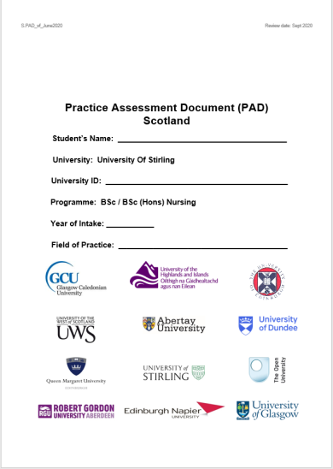

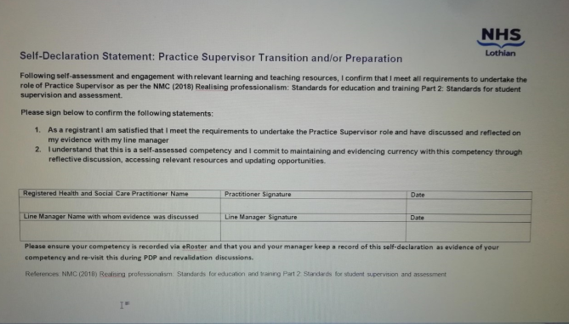
Your Steps to becoming a practice assessor.......
PA specific NES Learning resources
Discuss with line
manager
Be aware of key documents
HEI
Partners
Assessment
Documents
Workshop
Via Microsoft
TEAMS
Discuss with
line manager
Record on e roster
Sign Self Declaration
Notes:
(Note for narrator- This slide describes the steps that make up the process of practice assessor preparation. An animation has been added so each stage comes one at a time as you describe them)
When you are ready to start preparing for the PA role you should discuss this with your line manager in the first instance
The next stage is to complete the reflective self assessment that is in the ‘Guide and record for nurses midwifes and registered health and social care professionals preparing for the role Practice Supervisor and Practice Assessor. We will talk more about this document and the self assessment later in this presentation (next slide).
Part of the reflective self assessment will be to identify your learning needs in relation to the PA role and depending on what these are, the next stage in the process will be to access relevant learning resources, these will include the NES learning units 1-6
There are other key documents we would recommend you look at prior to undertaking the role of practice assessor. We will refer to these later in this presentation.
It is recommended that you familiarise yourself with the student documentation so that you feel confident to record the student’s final assessement and you are also encouraged to find out who the academic assessors are for your practice learning environment.
Once you are ready you will sign a self declaration and discuss again with your line manager that you have completed PA preparation. It should then be added to e- roster.

Slide 5
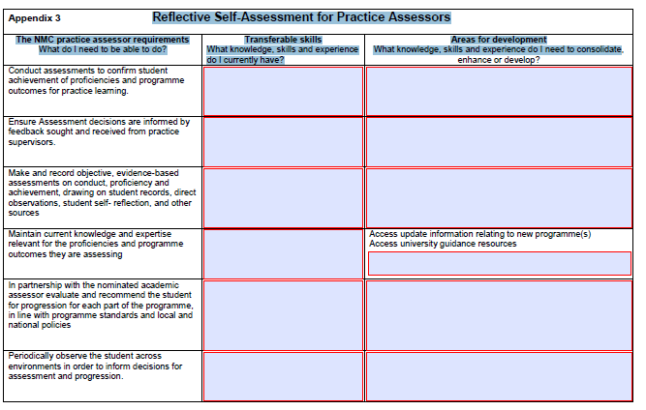
Complete the Reflective Self Assessment tool for Practice Assessors
8
Notes:
Here is an image of the Reflective Assessment Tool for Practice Assessors that you will find Appendix 3 of the ‘Guide and record for nurses midwives and registered health and social care professionals preparing for the role Practice Supervisor and Practice Assessor. You will be familiar with this document from when you were preparing for the role of practice supervisor. Remember that within the document there are some helpful suggestions of resources that you can access to address if you have any identified any specific learning needs.

Slide 6
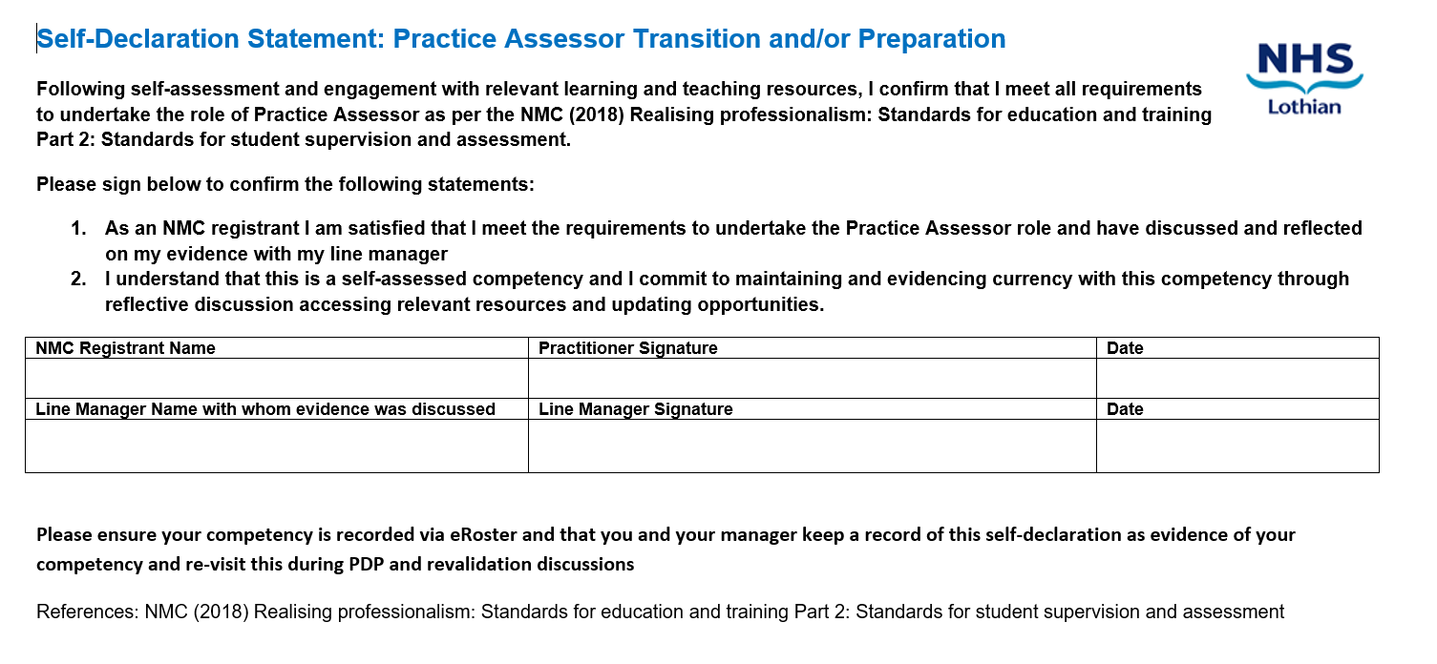
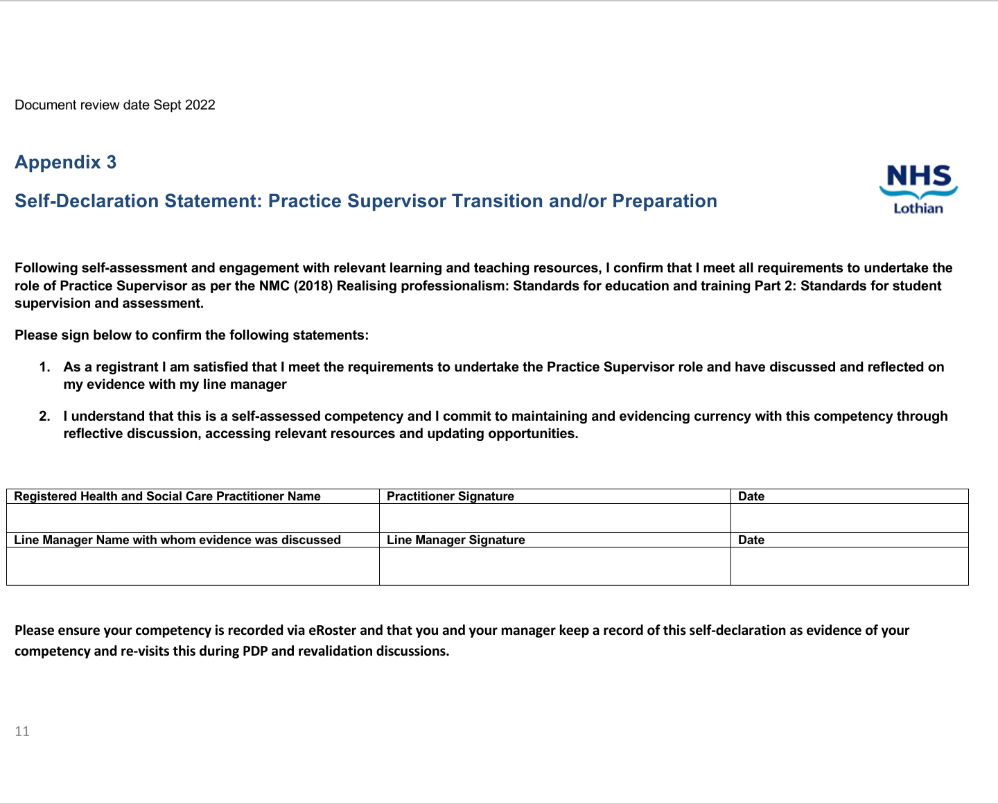
Self Declaration
Your Practice Assessor Preparation should also be recorded on e - roster
Notes:
At the end of the document there is an important section where you sign to say that following the learning you are satisfied that you meet the requirements to become a PA – similar to the one you completed when you were preparing for the role of PS. Again, this is discussed with your line manager who also signs the document and then the line manager can ensure that this new competency is then recorded on e roster if your area uses e-roster

Slide 7
NES Learning Resource
Unit 1
Roles and Responsibilities
Unit 2
Learning Theory
Unit 3
Creating a Positive Learning Environment
Unit 4
Feedback
Unit 5
Assessment
Unit 6
Supporting Learners: Responding to performance concerns and supporting development and progression
Notes:
It is likely that you will have completed the NES learning resources as part of your preparation for becoming a practice supervisor.
However, it may be worth revisiting some of these to develop and enhance your skills as you take on the role of practice assessor. Units 4, 5 and 6 are particularly relevant to the skills required of a practice assessor. The link within the title of this slide will take you directly to the NES resources page.

Slide 8
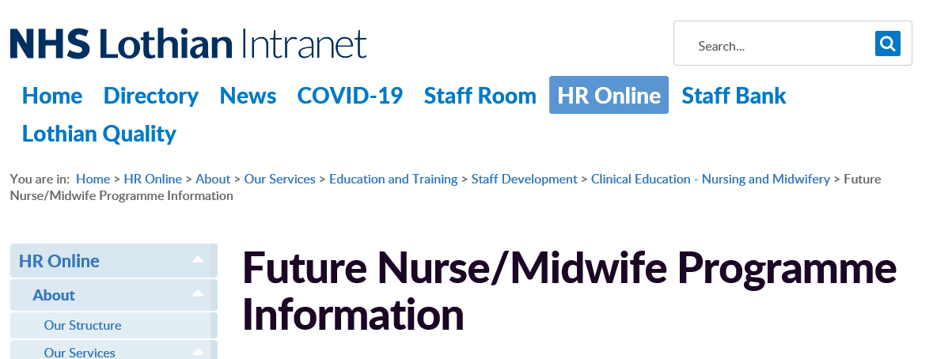

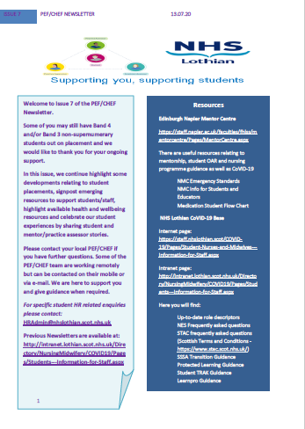

NHS Lothian resources to support you throughout your journey
 | NHS Lothian Future Nurse and Midwife Education Programme Intranet site
 | Edinburgh Napier University Mentor Centre: (Practice Learning Hub) representing ENU, Edinburgh University and QMU
 | PEF/CHEF newsletter
 | 1:1 support from your local PEF/CHEF
 | Ongoing CPD opportunities for practice supervisors and practice assessors arranged by PEF/CHEF team
Notes:
This slide provides a brief reminder of the resources available within NHS Lothian to support you with your roles of practice supervisor and practice assessor. These complement the NES national resources.
The NHS Lothian Future Nurse & Midwife Programme page contains valuable information and is regularly updated with any new developments or useful resources.
If you do not have access to the NHSL intranet site such as those of you who work in care homes please contact your local PEF
You can access any of the other resources by clicking on the hyperlinks in this presentation or by using your preferred internet search engine.

Slide 9

Next steps...........
Complete record and guide including self assessment
Identify learning needs & access learning
resources to complete your preparation
Attend practice assessor workshop, ask line manager to update e-roster if applicable
Work with students as a practice assessor with support from more experienced PA/line manager and PEF/CHEF
Workshops will offer an opportunity for shared learning and discussion between new practice assessors, will be facilitated by the PEF/CHEF team
Notes:
(Note to presenter -Steps will appear one at a time , explain each step as they appear)
Now to recap on your next steps to becoming a practice assessor.
Firstly complete the self assessment tool in the NHS Lothian ‘Guide and record for nurses midwives and registered health and social care professionals preparing for the role Practice Supervisor and Practice Assessor. ‘
Identify learning needs for the practice assessor role and access the relevant resources.
We strongly recommend that you attend the interactive workshop to consolidate and support your learning. These will be facilitated by a member of the PEF team and are available to book on eESS. Details of the content of the workshop are provided on the following slide.
When you have finished your preparation you will be ready to work with students as a practice assessor with the support of a more experienced PA, your line manager and the PEF team
Remember to visit the NHSL future nurse and midwife intranet page regularly for links to all the resources and updates.

Slide 10

Practice Assessor Workshop
Discuss the roles of the practice supervisor, practice assessor and academic assessor and how they work together to assess students
Develop the skills for completing a fair, timeous and objective student assessment
Recognise success and identify the key skills required in providing constructive and timely feedback
Discuss the role of the practice assessor in responding appropriately to the underachieving student
Identify potential reasonable adjustments within the practice learning experience which may be required to support effective student learning and assessment
Notes:
Here are the Learning objectives for the NHS Lothian Practice Assessor Workshop.
During the interactive session you will have the opportunity to deepen your understanding of how the roles of practice supervisor, practice assessor and academic assessor work together to support and assess students and to create a positive learning environment.
Through discussion and activities you will also explore how to enhance and develop the skills required to provide constructive and timely feedback as well as those required for completing a fair and objective student assessment. Through case studies there will also be the opportunity to discuss the role of the practice assessor in responding appropriately to the underachieving student and in identifying potential reasonable adjustments that may be required to support effective student learning and assessment.

Slide 11
We hope you enjoy the next part of your journey!!
Notes:
We really hope that you will enjoy the next part of your journey and don’t forget the NHS Lothian PEF team are always happy to help and support you along the way.

