Slide 1

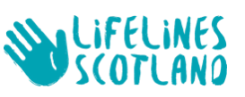
A guide on how to run a Lifelines online session.
Basic steps, hints, tips & advice.
Delivering Online training
Notes:
This booklet covers all the slides in the power point presentation.
The booklet and power point can be accessed from the Resource section on the Lifelines Facilitators page.
Please note though that the Facilitators page will be replaced by the Dashboard.
The booklet has been created to guide those new to delivering Online sessions and covers all the basics, step-by-step. Delivering for the first time can seem very daunting, but as time goes on, you’ll find that it is straightforward, and you’ll settle into it.
For those more familiar with delivering online, you may only require slides 3 to 7 which cover details individual to a Lifelines session: such as creating the session, co-facilitators and sending the link to delegates. Even if you are experienced, you may find it useful to have a quick flick through the presentation in case there are any tips that may be beneficial.
For this demo MS Teams was used. It is similar, but not identical to platforms such as Webex, Google Meet, Zoom etc.
The demonstration on the power point covers;
How to create a Teams online session and send the link directly to delegates. OR once the Dashboard is in place, the link will be copied and forwarded by this system.
Highlighting some of the settings you may require.
There are tips added that are useful and are highlighted in the red box on some of the slides.
Advice that will hopefully assist to make the session run smoothly.
Before you start delivering the modules, ensure that the link to “Lifelines Facilitator Resource area” is embedded on the browser. The logo for the browser should be on the lower ribbon of your screen.

Slide 2
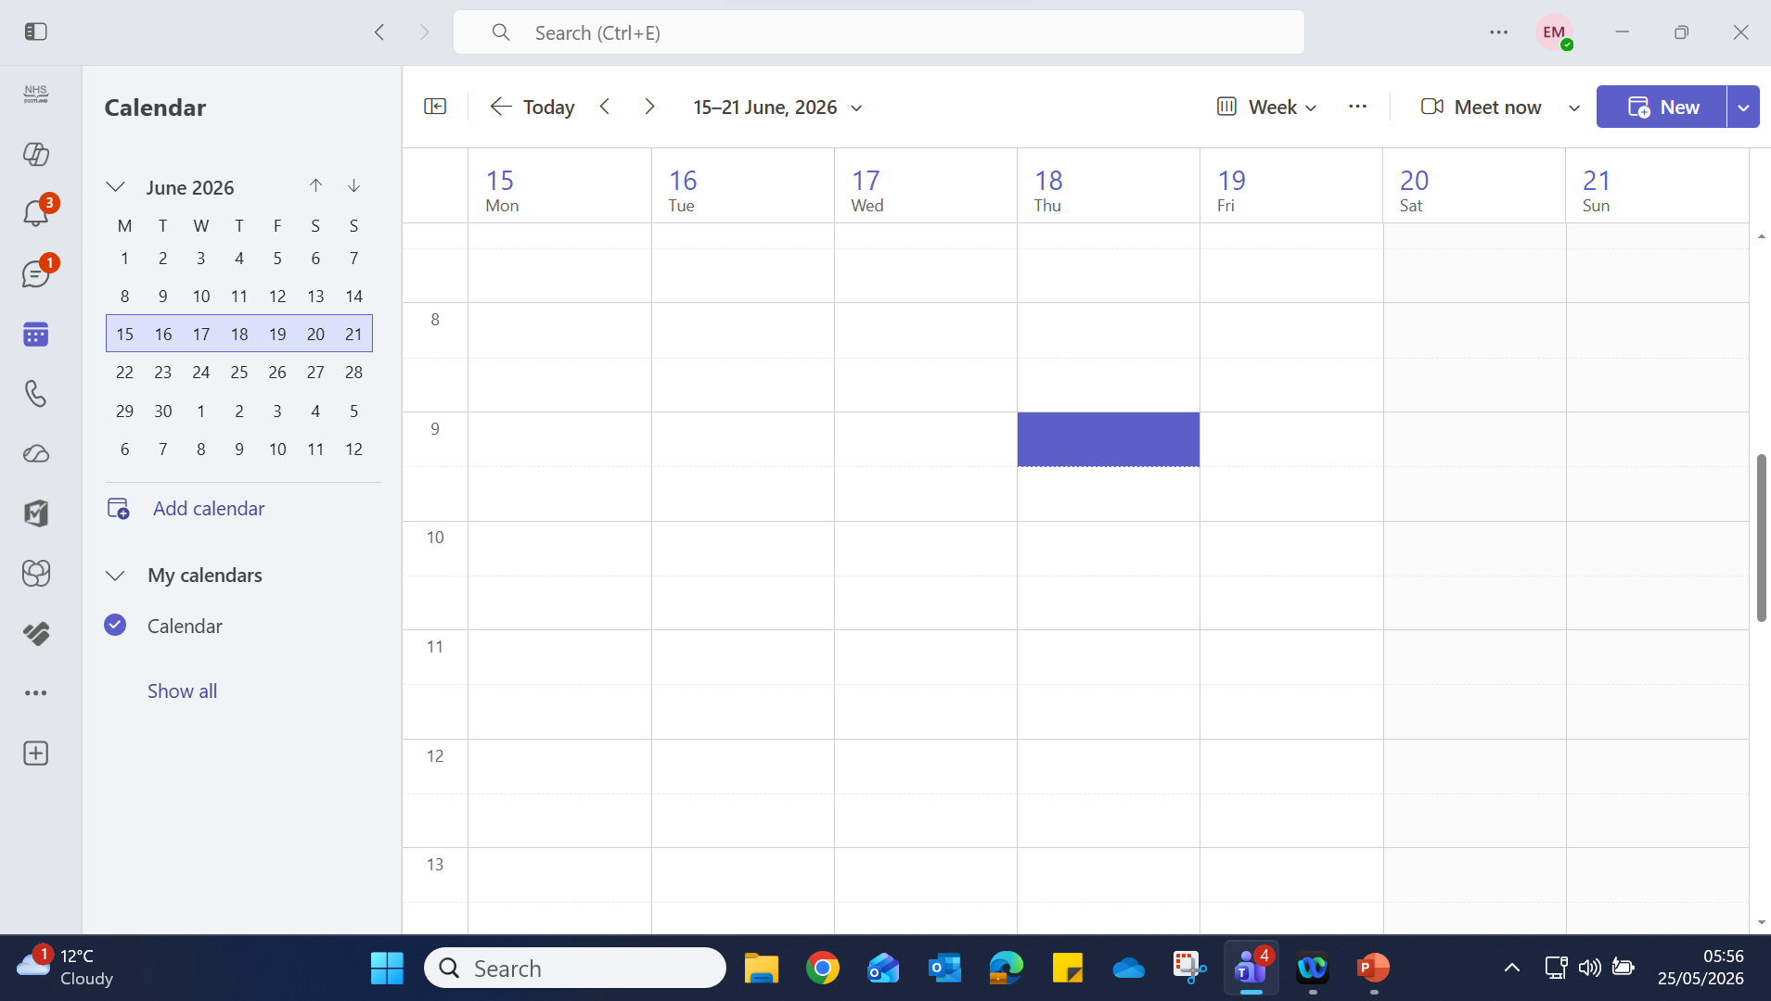
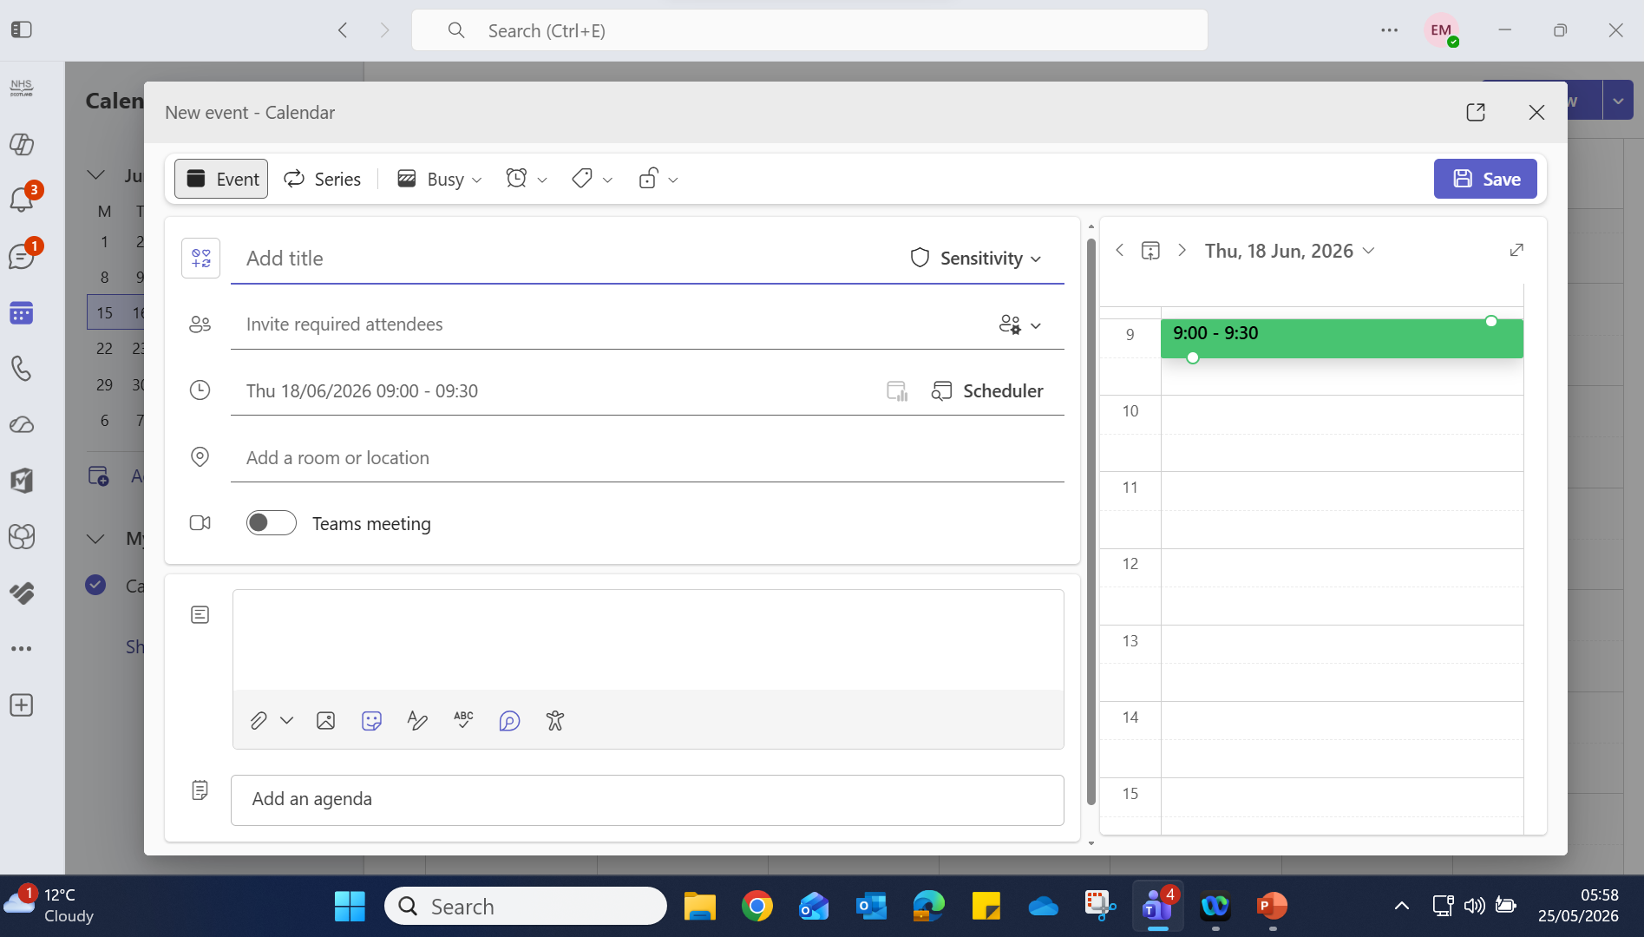

Logging the date for a Teams session
Click on Teams icon
Select calendar on the left-hand tab.
From the small calendar on the left, select the month using the arrows. E.g. June. Select the week in June.
On the main calendar, click directly on the highlighted date and the time you wish to start the session
Click “New” in the top right- hand corner.
.
The screen will change.
A schedule will come up.
The date, Thursday 18th June is displayed.
Notes:
After downloading MS Teams onto your laptop, pin Teams on the bottom bar of the desktop screen.
From this, open Teams, and from the left-hand tab, select the calendar symbol.
A small calendar on the left-hand side of the screen will come up. Use the arrows to select the month that you are running the session. In this example, June 18th has been selected. Select the week in June that the 18th falls on - which is the 3rd week. Click on it and the week will be highlighted.
Now look at the large main calendar, that week will be displayed. Select the day, i.e. Thursday the 18th June and the time you wish to start the session.
Click “New” in the top right-hand corner. The screen will change, as in the second diagram.
A schedule will have come up. The date is displayed.

Slide 3
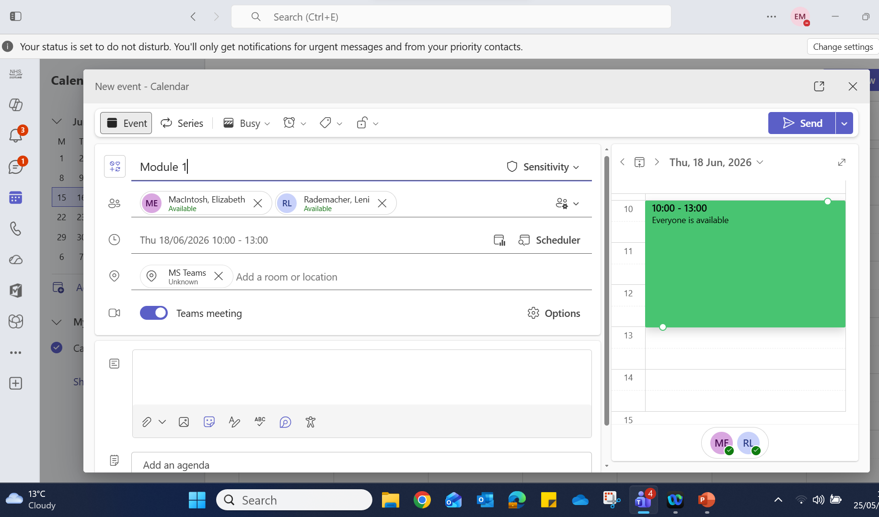
Creating the Teams session
Name the session
Type in your own email address and other co-facilitators that are involved. Do not add the participants email addresses at this stage.
Adjust the time according to the content you will be covering.
For location select MS Teams.
Click on “Options”……..
TIP! Double check the date and time are correct after entering it
Notes:
Give the session a title – for instance, “Module 1” and/or the full title, “Staying Well, Understanding Resilience and Self-care.”
At “Invite required attendees” type in your email address and any other facilitators that are involved. This means you all have the same link, and this will be the link which will be sent later to the delegates. Do not add the delegates email addresses at this stage.
Adjust the time according to the content you will be covering. Using this example of Module 1, allow 3 hours for the session. This will give you time for introductions and ample time for discussions. Nobody will be upset if you finish a few minutes early, but it is irritating if a session runs-over late.
For location select MS Teams. Ensure the button below reflects this.
Just before the next instruction, double check the date and time are correct. (It sometimes changes!)
Click on Options……..

Slide 4

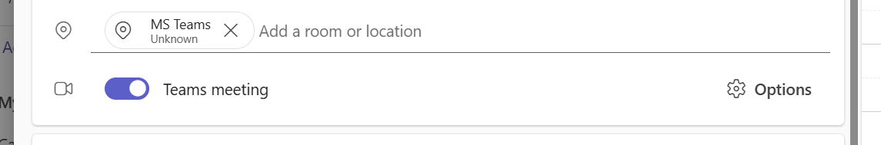
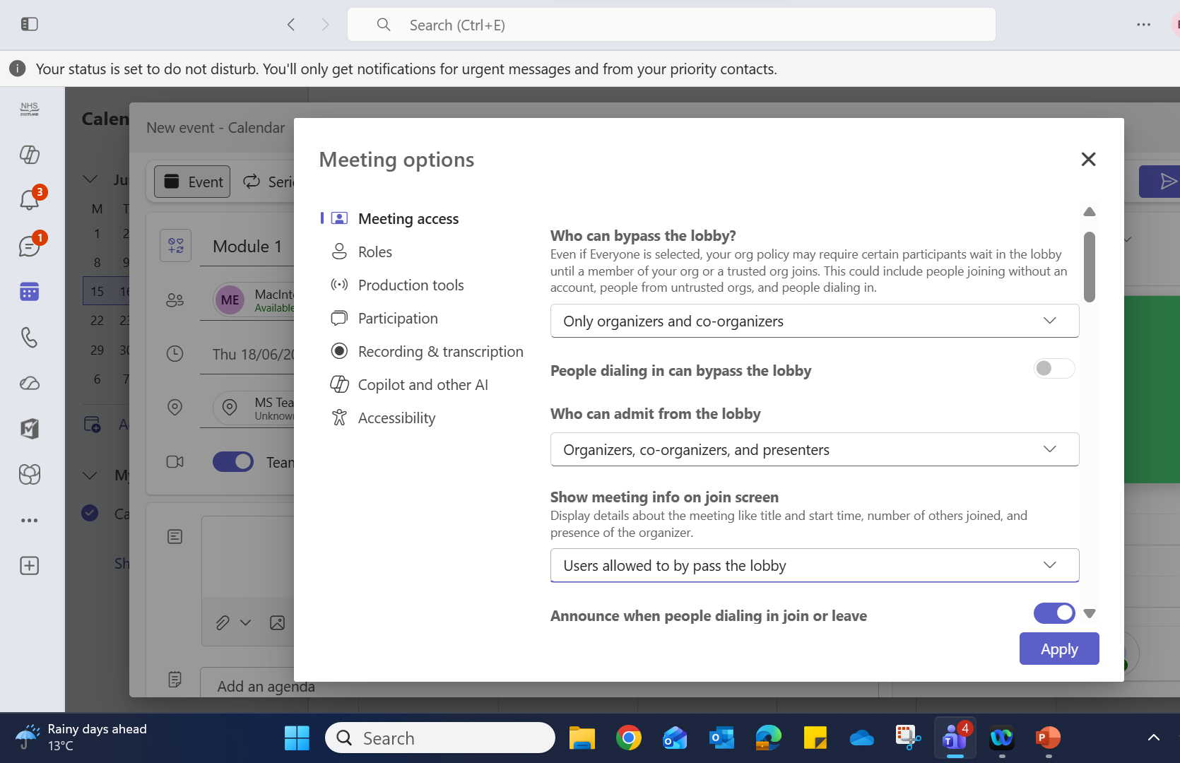
Options – Managing access
Click on “Options” and select those suitable for your session.
Only the ones you see, are the ones we would suggest that you set.
Continue down the Options menu…..
Notes:
The Options tab allows you to tailor
Meeting access,
Roles,
Production Tools,
Participation,
Recording & transcription,
Co pilot and other AI,
Accessibility.
A lot of these options you do not need to alter, therefore we have not shown them. The ones suggested to alter, are shown . The ones that are not mentioned have not been changed.
The term “Organiser” in Teams, is you as a Facilitator who has set up the session.
The term “Co-organiser” or “Presenter” in Teams refers to additional facilitator/s who are taking a proactive role in the session.
This proactive role may be;
Delivering some of the exercises e.g. one facilitator leads module 1, 3 & 5, the other facilitator does module 2 & 4.
Or it could be
Whilst someone else is delivering, the 2nd person is organising all the background work such as admitting delegates to the session, allocating delegates to the break-out rooms, opening and closing the break-out rooms, starting and stopping module films, running the two independent films in Module 4, and overseeing the chat box etc.
A colleague* could do the background work for you if you are new to presenting online. For the first couple of times having someone deal with the tech side of things allows you to concentrate on the materials but in time you should manage this yourself.
(*Remember anyone that hasn’t been signed off as a facilitator, should not be leading the discussions.)
Continue on down the Options page…..

Slide 5
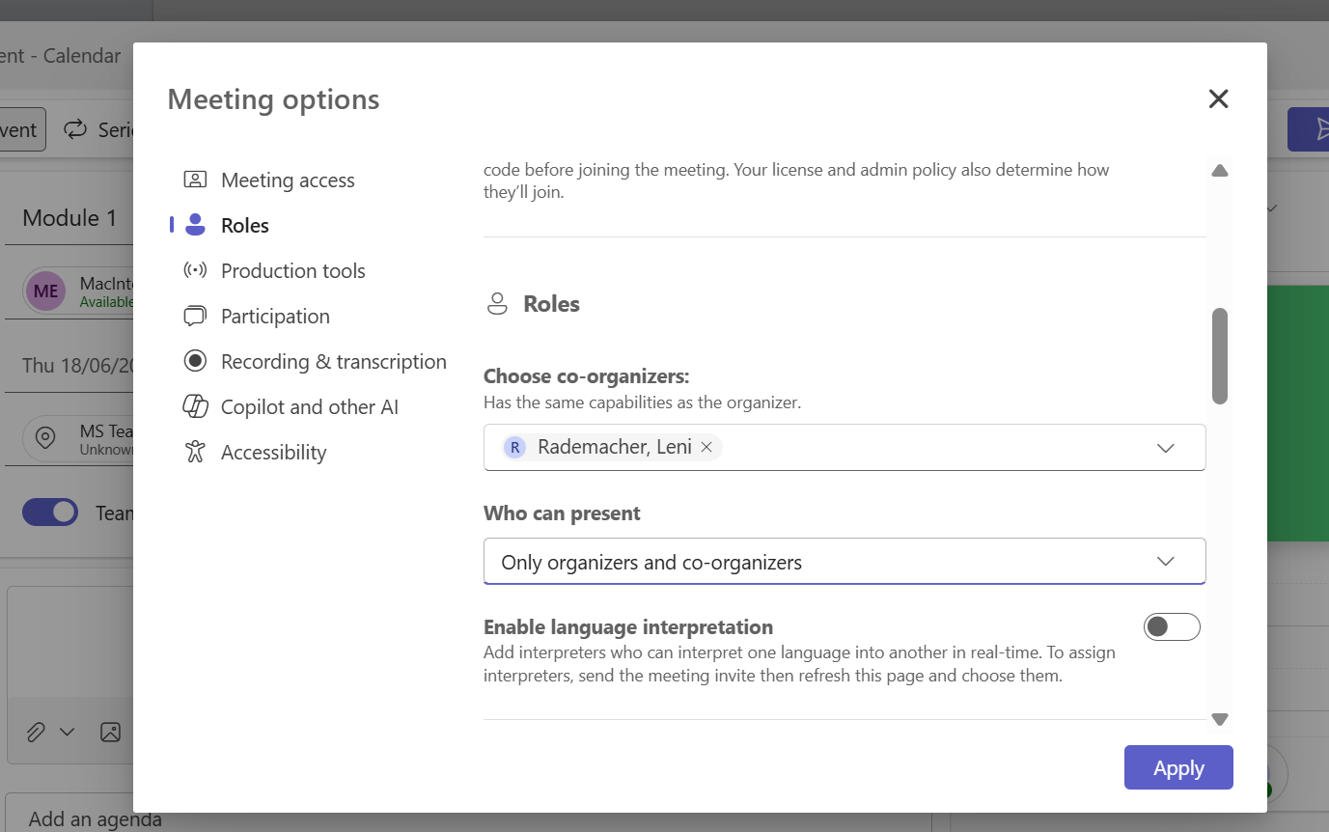
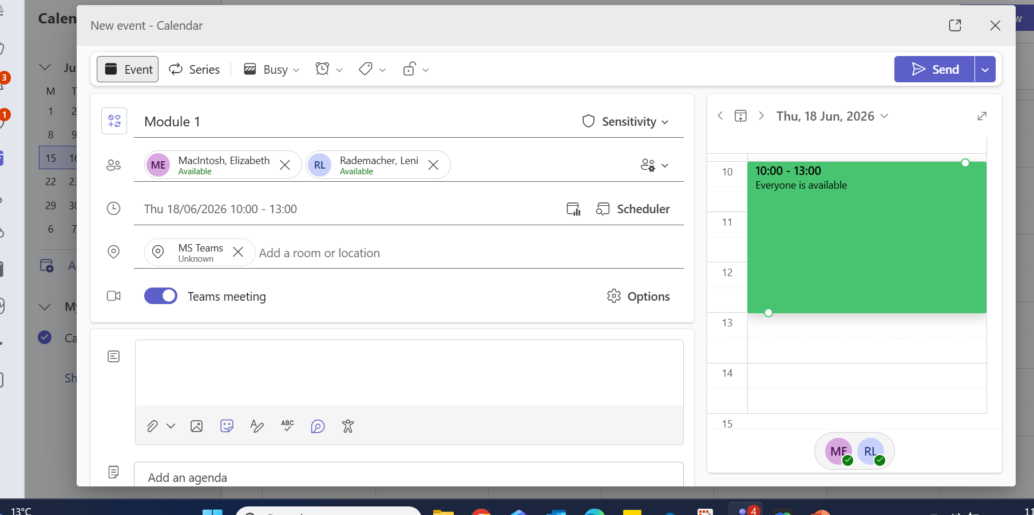
Options – Roles particularly if Co-facilitators
Add the email address of co-facilitator/s (co-organiser/s).
Hit “Apply” in the bottom right-hand corner.
TIP! Check beforehand that co-facilitators also have Teams.
In the Options menu check that delegates have microphone and camera access.
The screen will go back and if everything is correct, hit “Send”. Close down Teams.
Notes:
Under the heading “Managing access” – add the email addresses of other facilitator/s involved in the session.
Continue down checking that under the heading “Participation”, delegates have microphone and camera access. Please note that in Teams delegates are referred to as attendees.
Hit “Apply” in the bottom right-hand corner.
The screen will go back and if everything is correct, hit “Send” in the top right-hand corner. Close down Teams.
The additional facilitators will receive an email with an invite. Once accepted they can do a double check by clicking on the meeting in their Teams calendar (even though it is in the future, it should open-up which shows they have the ability to join.)

Slide 6
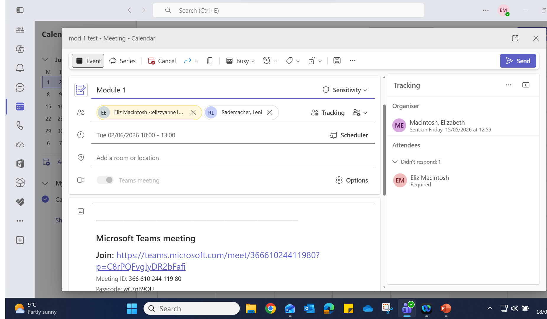
Click on the meeting on your calendar.
Copy the link for the Dashboard (or email into the joining instructions email*)
The link will be included in the Dashboard email meeting invite that is sent out to all the delegates.
* If Dashboard not in place
Sending the link
Notes:
When it is time to notify the delegates of the session, open the meeting on your Teams calendar and copy the link.
NOTE: If the Dashboard is not in place, the link will need to be copied to the joining instructions email.
If the DASHBOARD is in operation, copy the link which will be pasted into the Dashboard system when you register the session .
This covered in the next slide.
The link will be included in the email meeting invite sent out by the Dashboard and is sent out to all the delegates.
This is the link that you will open 15-20 minutes before the session.

Slide 7
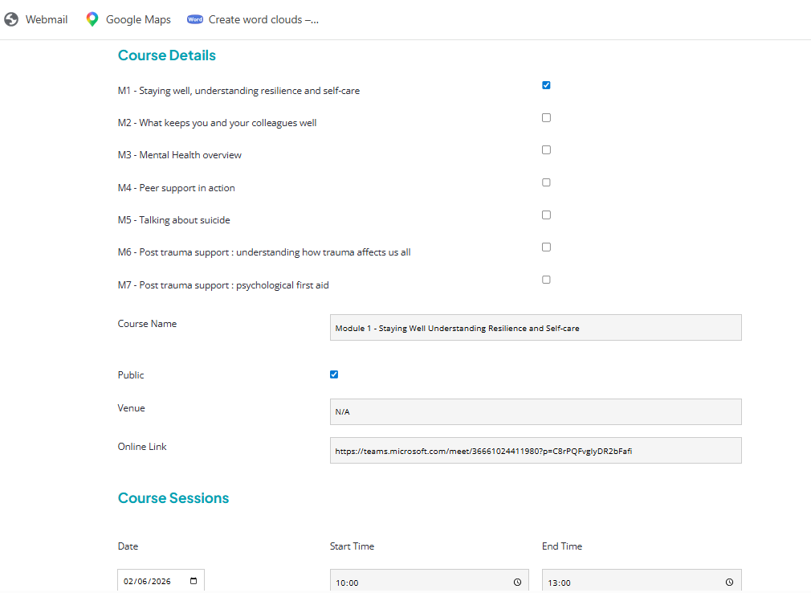
Dashboard
When completing the details of the course on Dashboard, add the Teams link.
This means that all the joining instructions, pre-course materials, survey links etc will be sent to the delegates.
Notes:
When completing the details of the course on the Dashboard, add the Teams link.
This means that not only will the meeting link be automatically sent, but all the joining instructions, pre-course materials, survey links etc will also be sent to the delegates.

Slide 8
On the day
Open Teams meeting about 15 -20 minutes beforehand.
The Chat, People, Rooms tabs are the ones you will use. When selected from the ribbon, they all open up on the right-hand side of the screen and can be opened and closed as required.
Have the “People” tab open as delegates join, you will see their name appear in the right- hand column. Each tab can be opened and closed at anytime .
Ask participants to switch on camera and microphone if they haven’t already.
TIP! If delegates are having camera problems, ask them if the shutter on the laptop cover is possibly closed.
Notes:
On the day of delivery, open the Teams session and a ribbon of commands at the top of the screen, will be available to all facilitators.
The People symbol can be opened to see who has joined the main room.
The Rooms symbol is for creating the breakout rooms.
A further explanation about the People and Rooms menu is in the next slides
Noe: The delegates do not have the same amount of access and therefore can’t create rooms or share material.
The Chat symbol is for text.
As delegates join, ask them to switch on their cameras and by greeting them, They should respond which indicates their microphone is working. If they are having camera problems, ask them if the shutter on the laptop cover is possibly closed. For sound – have they switched on the microphone?

Slide 9
Delegates joining – People tab
If the “People” tab is open the names will appear in a column on the right-hand of the screen.
A sound will alert you as delegates join, hit “Admit” and this will allow them to enter the Main room.
You can also “mute” them if there is background noise at their end.
Once started, even when the “People” tab is closed, it will still show the total number of delegates in the main room. This acts as a good indicator when delegates are coming back from the breakout rooms, the counter will go up. It also indicates when delegates “drop out” of the session
TIP! Remember yourself and any other co-facilitators are part of the total!!
Notes:
If the “People” tab is open, the names of the delegates joining will appear in a column on the right-hand of the screen.
As they join a sound will alert you so hit “Admit” allowing them to enter the Main room. You can also “mute” them if there is background noise at their end such as chatter in their office or home.
When the “People” tab is closed, once the session is underway, the people icon will still show the total of number of delegates in the main room. This acts as a good indicator when delegates are coming back from the breakout rooms – you will see the counter go up. It also lets you know if delegates have dropped-out
Tip: Remember that in the main room, yourself and any other co-facilitators are part of the total!!

Slide 10
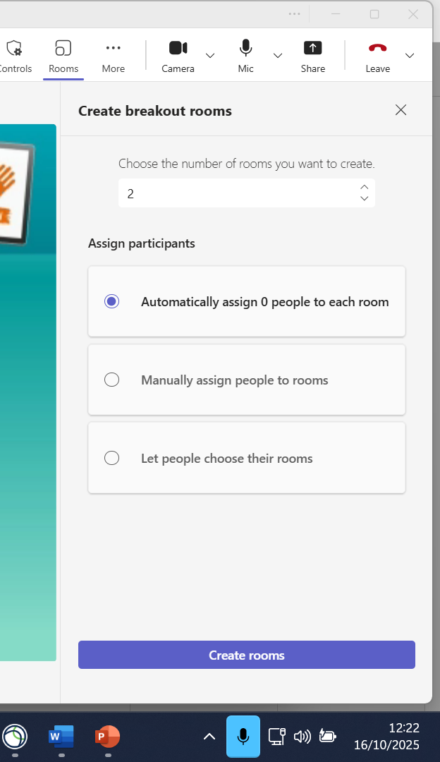
Break-out rooms
Once delegates have joined:
Select how many rooms are required. Limit rooms to 4 or 5 delegates.
Under “Assign participants” (delegates) select either;
“Automatic” which is useful for groups of the same base/job role etc.
or
“Manual” if a mix is required due to a variety of work base, job role. etc
Click “Create rooms” which will bring-up another screen with the list of names and you can allocate each person to a room.
Then click “Assign participants” tab.
Those that can’t be assigned will be a group that stay in the main room.
Facilitators switch off camera & microphone, and mute volume.
Notes:
Setting up groups for break-out rooms.
Allocate delegates to rooms, whilst the first part of delivery is playing. i.e In module one between the start and 02min:46sec. Either set the rooms up automatically or manually. Automatically is suitable for delegates who all work in the same area and know each other. Manual allows you to mix people who are from different areas/different roles etc.
Check the section ‘Assign participants’ to make sure everyone has been allocated a room. Sometimes people coming in from a personal device can’t be allocated a room and this will show up as “Unassigned”. As they can’t go into a room they will stay in the Main Room during the exercises, and you may need to pop the whole group in the main room (so cancel the room allocation for this group.).
As facilitators are in the main room, they should switch off their camera and microphone and mute the volume (making sure you can’t hear their conversation).
Numbers – it is best to have no more than 16 folk attend a session online, if you have low numbers, reduce the number of rooms rather than have rooms with only small groups such as 2 people. The smaller the group, the width of discussion is reduced. If there are only two groups in total, choose two scenarios to allocate. If time permits, you can do the third scenario as a whole group discussion.

Slide 11
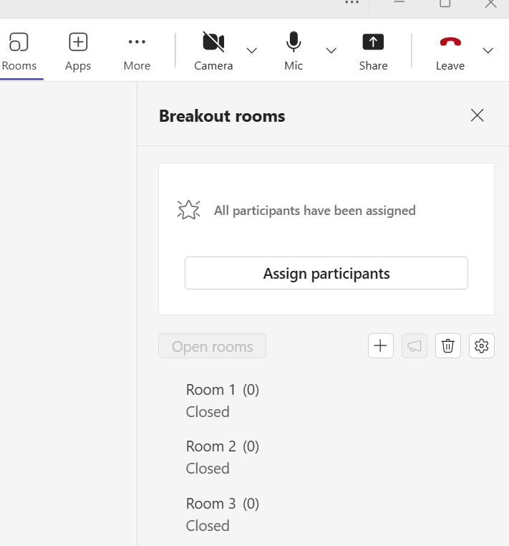

When rooms are open
+ extra rooms can be created
typed messages to go to the breakout rooms.
set time limit for discussions in breakout rooms
Click tab to open or close rooms manually.
By clicking on each room heading , it shows the delegate’s names in that room.
If at any time you need to change or move delegates into other rooms, click on their name and select the room.
Then click “Assign participants” tab again, to save.
Notes:
When you are ready to start hit “open rooms”. This will change to “Close rooms” when the groups are in break-out. Next to this button are symbols.
The number of rooms has already been set but in case an additional room is required, the+ sign allows you to create rooms.
The bin can be used to delete highlighted rooms.
The microphone is for texting messages, such as “You have five minutes left” or “Remember to allocate a spokesperson”.
The cog symbol opens up and allows you to set a time be for discussion in the breakout rooms. Delegates will automatically be returned to the main room after the set time has run. (the advantage of that is that if you get preoccupied, the rooms won’t run on any longer than the maximum time you decided on) If you decide to close the rooms sooner, by hitting “close rooms” will override the timer
If at any time you need to change or move delegates into other rooms, click on their name and select the room. Then click “Assign participants” tab to save.
By clicking on a particular room in the right-hand column, it will tell you the delegate’s names in that room.
You can ask who is the spokesperson for the group i.e “In room one, John, Jane, Jack, Jillian and Jason – who is giving us feedback?”

Slide 12
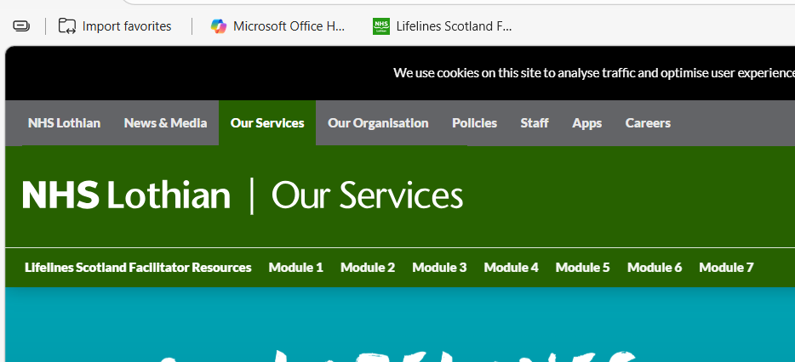
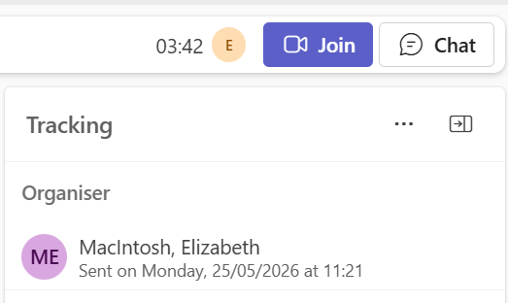
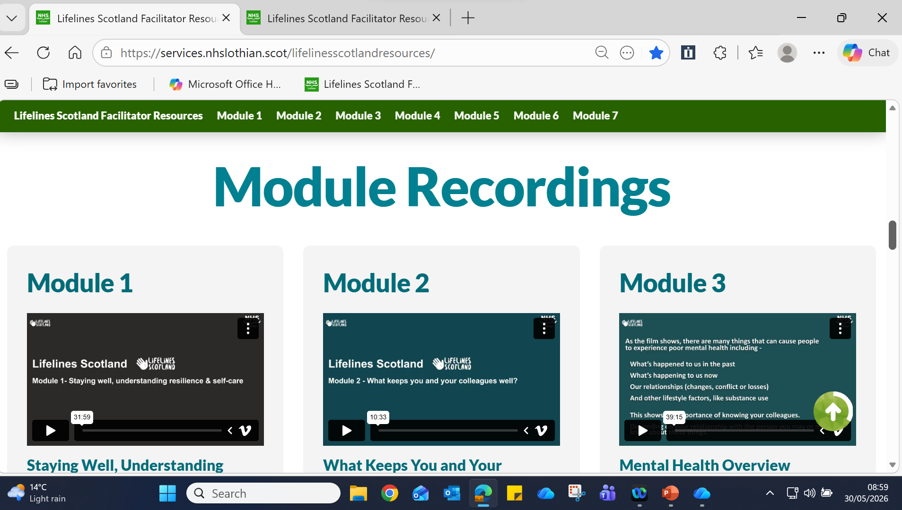

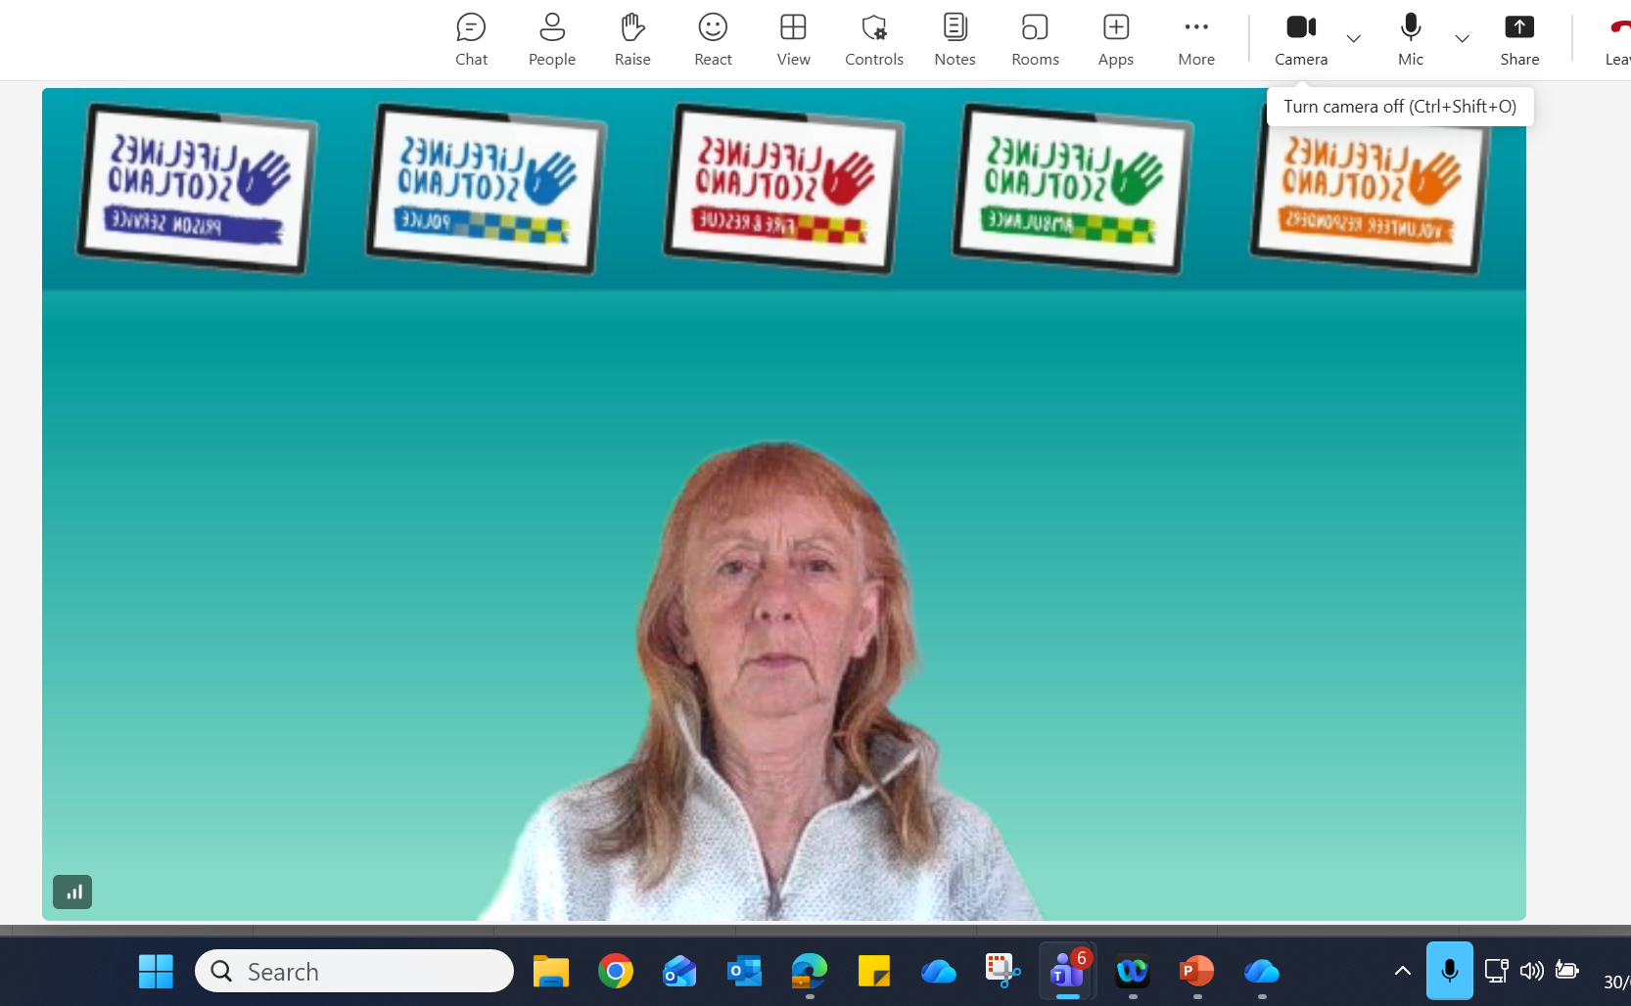
Share content prep
First select the browser on the lower ribbon of the screen.
This will then show the “Lifelines Facilitator Resource Area” tab, on the top ribbon. Click to open.
Stay on the Home page and scroll down to the Module to be shown. Do not click on the selected module yet.
Minimise the page.
15 to 20 minutes before the session, join the Teams meeting.
Switch on your camera and microphone.
Notes:
Before delegates join, select the browser on the lower ribbon of the screen.
On the top ribbon open the “Lifelines Facilitator Resource Area” tab. The home page will open as you can see in the top diagram.
Scroll down to the Module to be shown. Do not click on the selected module yet.
Minimise the page. That means it is sitting in the background (so to speak) for you open when you’re ready to start the session.
15 to 20 minutes before the session, join the Teams meeting.
Make sure you switch on your camera and microphone.

Slide 13
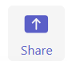
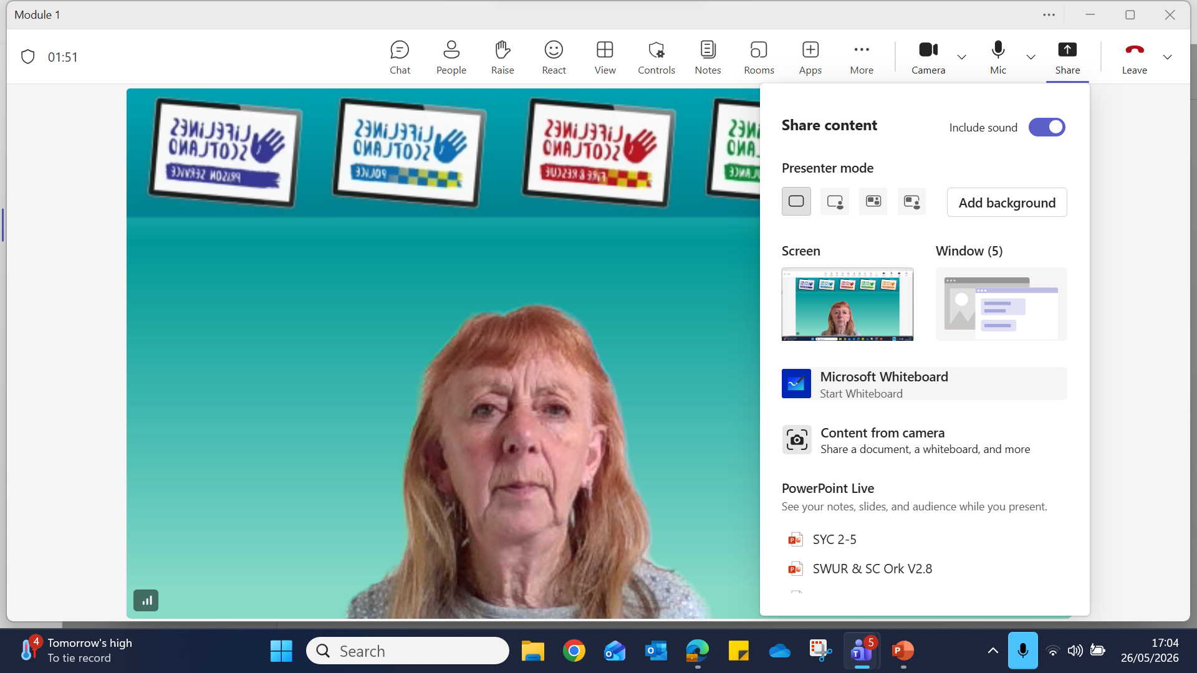
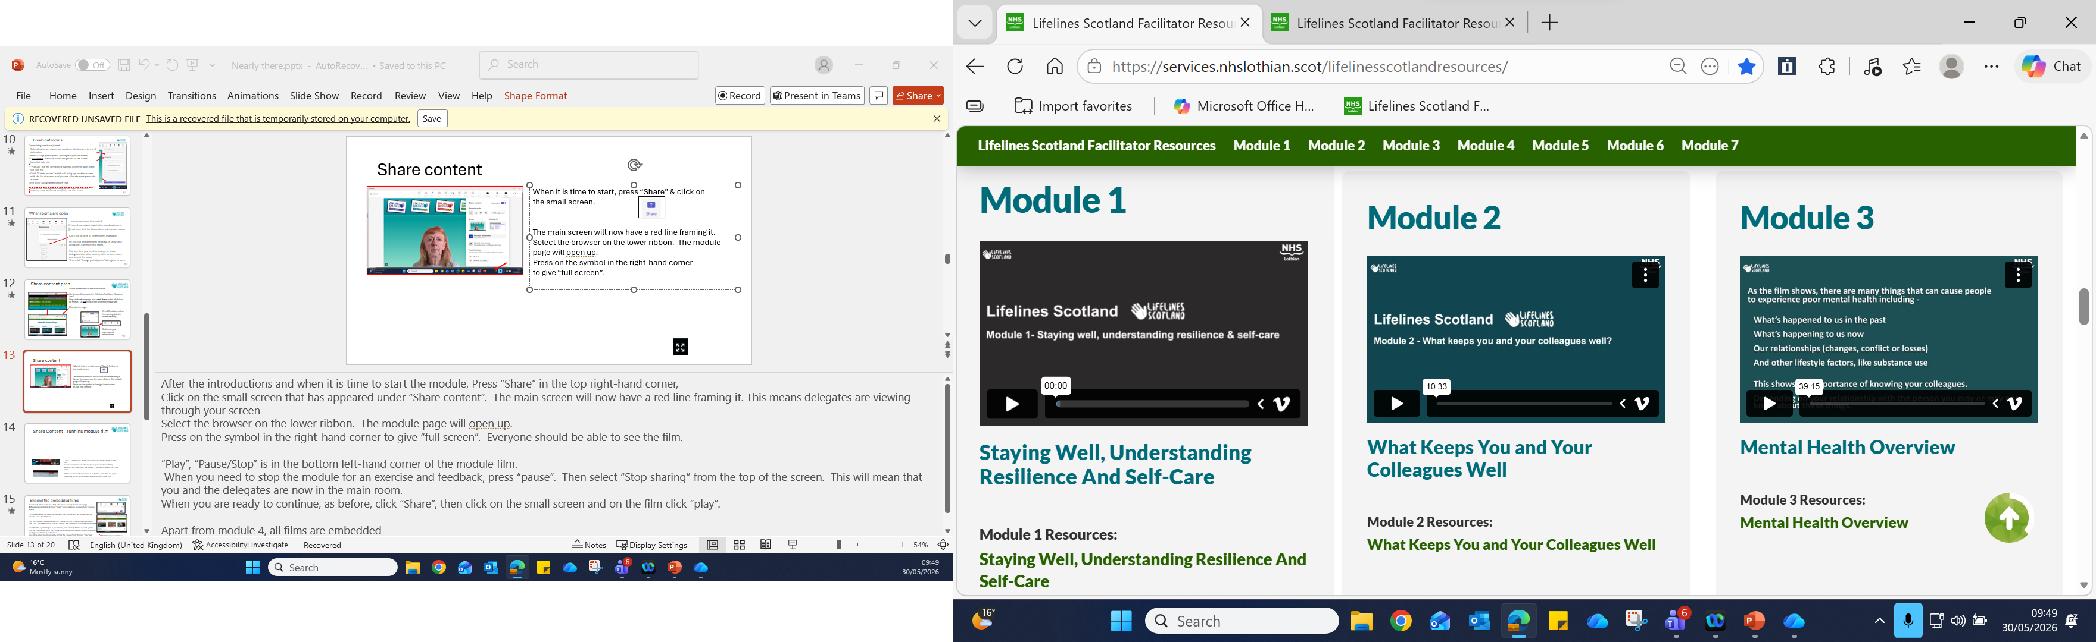
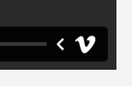


Share content – delivery
When it is time to start, press “Share” Click on the small screen.
The main screen will now have a red line framing it.
Select the browser you are using, on the lower ribbon of the screen.
The module page will open up.
To gain full screen, press on the arrowhead
It will open up to the left
Select “Extend screen”. Then select “play” on the left-hand side
Notes:
After the introductions and when it is time to start the module, Press “Share” in the top right-hand corner.
Under the heading “Share content”, click on the small screen that has appeared.
The main screen will now have a red line framing it. This means delegates are viewing through your screen.
Select the browser you are using on the lower ribbon. The module page, which was opened earlier, will open up.
On the module you want to show, press on the arrowhead down in the right-hand corner.
This will open to the left and you can press on “extend screen”.
This will give “full screen”, and everyone should be able to see the film.
Then select the “Play” arrow on the left-hand corner.

Slide 14
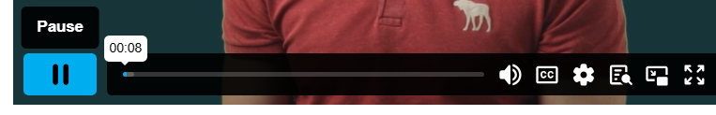
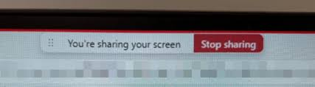
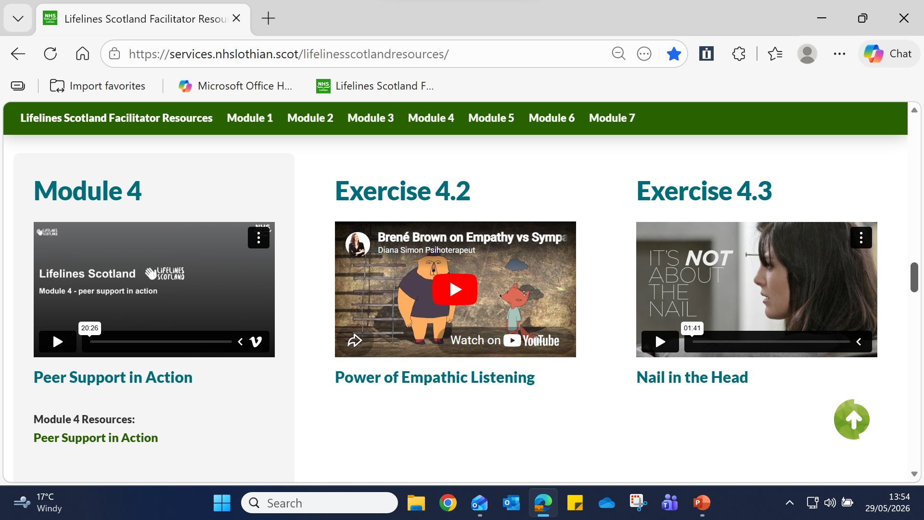
Share Content – during delivery
“Play”/“Pause” are in the bottom left-hand corner of the film
Press “pause when you need to stop for an exercise & feedback.
Select “Stop sharing” from the top of the screen. Everyone is now in the Main room.
When you are ready to continue, as before in the previous slide,
Click “Share”, click on the small screen and then the “Play” button on the film.
TIP! Follow the instructions in sequence!
Modules 4 - “Nail in the Head” & “The Power of empathic listening” in module 4 are NOT embedded.
As in the last slide, select this module from the Facilitator Resources home page. The two films are also there.
Notes:
The “Play/Pause” arrowhead is in the bottom left-hand corner of the module film.
When you need to stop the module for an exercise and feedback, press “pause”. Then select “Stop sharing” from the top of the screen. This will mean that you and the delegates are now back in the Main room. It is important that you do this in the correct sequence.
When you are ready to continue, as before, click “Share”, then click on the small screen and on the film, click “play”.
In all modules the films are embedded, However in module 4, there are two films that are not. “Nail in the Head” and the “Power of Empathic” listening. When you require the films, select them from the Resource page.

Slide 15
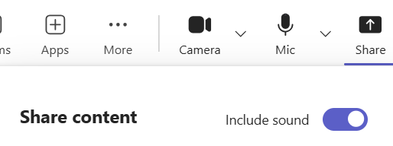
Sharing the module 4 films
When you require the 2 films in Mod 4, when you reach 4.39min / 10.18min click on:
“Pause” (bottom left-hand corner of Mod 4 film)
Press “Esc” (top left on keyboard) this returns you to the Resource page. Turn on “Include sound”
Click on film, extending the film as you do so.
“Play” film – Press “Pause” at the end.
Press “Esc” to go back on the Resource page. Continue with Mod 4 film by clicking on the film.
During Module 4 if at anytime you want to open the Main room for discussion.
Pause film, hit “Stop Sharing”
Then to go back to Module 4 – press “Share” in top right and click on the small screen.
When playing the two films, it is not
possible to go into the Main Room.
TIP! If delegates can’t hear the films, “Stop sharing” will take you back to the Main room. Press “Share” and “Include sound”.
Notes:
When you are running Module 4 use the information in the last two slides in conjunction with this one. This slide explains how to insert the two films within Module 4. It is a good idea to have a few practices beforehand so as you get used to how it works.
When selecting Module 4 click on “Share” and you MUST also push the slider to “Insert sound” as whilst you may hear the films, the delegates might not. Then click on the small screen.
Play the Module 4 session & use the “Pause” button at the appropriate place. 4.39min- Nail in the Head, 10.18min- Power of empathic listening
To come out of Module 4, press “ESC” on the keyboard – top left corner. This will return you to the resources page. Again, it is important to do this in the correct sequence.
To start the films, click on the one you have selected. Use the “Play” and “Expand” symbols individual to each film. The films should be left to run to the end.
Stop films when they are finished by using the “Pause” button. Pressing “Esc” will return you to the Resource page and you can resume by clicking on Module 4 and pressing “share”.
Remember for group discussions after each film, hit the “Pause” button and then at the top of the screen “Stop Sharing” tab and this will take you to the Main room.

Slide 16
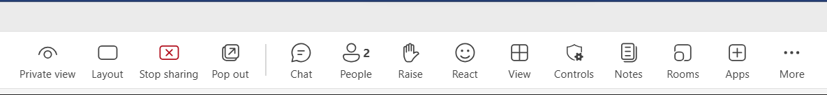
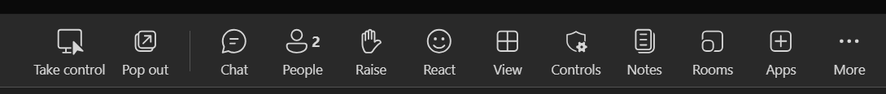
Two or more facilitators
The Organiser Facilitator must give permissions for the Co-organisers (co-facilitators) when setting up the meeting. See slides 3 & 5.
Before the presentation is open, the Organiser facilitator‘s top ribbon (from the left) will look like this.
Once the presentation opens the Co-facilitator’s ribbon (from the left) will look like this. Note they have access to “Take control” and the “Rooms” menu. (See note below)
Please Note! – The Organiser Facilitator and the Co-facilitator/s need to be on their organisation’s/service’s MS Teams. If the co-facilitator is on a personal laptop, the Teams app may NOT give the facility to use “Rooms” therefore the Organiser facilitator will have to run the breakout rooms. However, the capacity to share the presentation should be possible. Check a few days beforehand!!!
Notes:
When two or more facilitators are delivering the session – there is a need to hand/swap over “control” of the presentation.
REMEMBER it is important that when setting up the Teams session that the facilitator organising the session has listed any other facilitators taking part (Co-organisers) and given them permissions. See slides 3 & 5
Before the presentation is open, the Organiser facilitator‘s top ribbon (from left to right) will look like the upper illustration.
Once the presentation opens the Co-facilitator’s ribbon (from the left) will look like the second illustration. Note they have access to “Take control” and the “Rooms” menu. (See note below)
Please Note! – The Organiser Facilitator and the Co-facilitator/s need to be on their organisation’s/service MS Teams. If the co-facilitator is on a personal laptop, the Teams app may NOT give the facility to use “Rooms” therefore the Organiser facilitator will have to run the breakout rooms. However, the capacity to share the presentation should be possible. Check a few days beforehand!!!

Slide 17

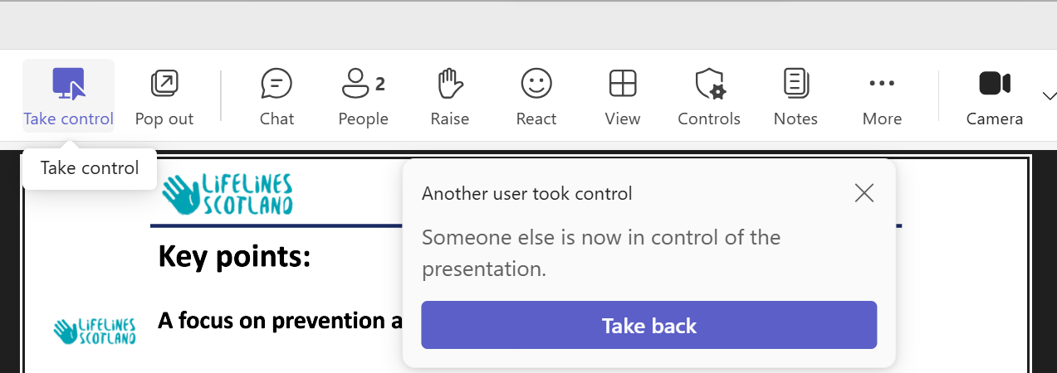
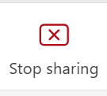
Two or more facilitators
Once the session starts whoever need to run the presentation, should click “Take control” or the Organiser facilitator can press “Take control” or “Take back” if necessary.
This will close down the presentation and show everyone in the main room
Notes:
When the co-facilitator wishes to present, they click on “Take control” and likewise when the Organiser Facilitator takes their turn, they press “Take control” or “Take back”.
The co-facilitator should be able to set up the breakout rooms, open and close them (slide 10 & 11) However this may not be possible depending on how the co-facilitator is accessing Teams. See note on previous slide.
When wanting to stop the presentation, whoever is delivering can click on “Stop sharing/presenting”. This can be during the session when there is an exercise discussion, and it allows all the delegates to be seen in the main room, or at the very end of the session.

Slide 18

On the day – Facilitator
Check the laptop is plugged in, wall switch is “on”, and the cable is secure in the power pack too!!
Have a list of names ready. (Key info & to ensure everyone is included).
And a blank page to note anything that needs to be followed up.
Have a glass of water to hand!!
Amplify personality online
Segue – particularly when swapping facilitators
Watchful of upset in delegates
Notes:
Check the laptop is plugged in, wall switch is “on”.
Ask people to have their camera switched on. If they don’t – ask if there is a problem as to why their camera isn’t on.
Keep a list of all those that you expect to attend. Keep a note beside their names of anything that you need or want to remember, such as job role or that they have to leave five minutes early at the end. It is a good idea to have the names listed according to groups. You can circle each person, as they take turn to be spokesperson with the feedback
Or
A dot beside each person’s name indicates that they have provided group feedback or have offered a comment. You can see who hasn’t spoken and ask them for their views at suitable moments. Its helpful as it allows quieter delegates to contribute
Take a note of any links/resources you have said you will send the group over and above the resources, so you can include them in the follow up email.
Have a glass of water to hand!!
Amplify personality online – in many ways it is like a radio presentation, so tone and expression need to be increased.
Segue – bridging the gaps – particularly when swapping facilitators. It can feel a bit broken if there is a silence whilst your colleague is loading the next module or film. “Now I am now going to hand over to Neave who will show you a film about mental health and is produced by….” or “Whilst Neave is setting up Module 2 consider ways to improve your work setting …”
Watchful of upset in delegates. Send a private message at a break if needs be, to check the person is okay.

Slide 19
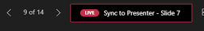
On the day – Delegates
Ask delegates to be on mute when not speaking.
If delegates are in a place with background noise, suggest they use earphones.
If in an office, warn others that they may be holding conversations for role play
Keep use of “chat” facility to a minimum unless requested to type in responses.
Reiterate that if delegates need to leave the meeting (temporarily or permanently, to put a note in the chat.)
If delegates find they are “dropping out”/freezing – closing down and coming back-on, often will resolve the problem.
The delegate realises that their screen isn’t showing the slide you are talking about. Ask them to press “Sync to Presenter” or use the right arrow below the slide show, to move it forward.
Notes:
Ask delegates to be on mute when not speaking. (Or you can mute them through the people tab ) It helps to reduce unwanted background noise
If delegates are in a place with background noise, such as office, suggest they use earphones. Background noise reduces concentration for the person.
If in an office, they should warn others beforehand that they may be holding conversations for role play. Their colleagues may wonder why they are saying strange things!
Keep use of “chat” facility to a minimum unless requested to type in responses. It is distracting for the person presenting.
Reiterate that if delegates need to leave the meeting (temporarily or permanently, to put a note in the chat.)
If delegates find they are “dropping out”/freezing – instruct them to close down and come back-on, often will resolve the problem.
If a delegate realises that their screen isn’t showing the slide you are talking about. Tell them to press the “Sync to Presenter” or use the right arrow below the slide show to move it forward.

Slide 20

Feedback suggestions
Get groups to rotate who is to be spokesperson.
Limit the number of points you want when taking feedback. Was their one element they had a lot of discussion around / disagreed?
Rotate the order groups feedback at each exercise.
If a number of groups, ask half of the groups for feedback and then the other half at the next exercise.
Ask questions – if group quiet – ask 2 or 3 delegates who haven’t spoken, what are their thoughts on the topic.
Notes:
Get groups for all the exercises to rotate who is to be spokesperson so as everyone takes a turn. Sometimes you find one person – with good intention, may dominate but it is preferable to get everyone involved throughout the session.
Limit the number of feedback points you want from each group i.e. 2 points. If not, the first group may cover nearly everything, and the other groups say the same. If everything is covered and a group is stuck what to add, ask – “Was their one element the group had a lot of discussion around / disagreed?”
Rotate the order groups feedback at each exercise. Don’t always ask Room 1 to feedback first. Take turns.
If there are a number of groups, ask half of the groups for feedback and then the other half at the next exercise.
Ask questions – if group quiet – ask a 2 or 3 delegates who haven’t spoken, what are their thoughts on the topic.

Slide 21
Problem solving
Note : Police Scotland & staff - Close down all background pages & test out Teams beforehand.
Difficulty logging onto Teams at your work base
Delete old Teams app shortcut off desktop and put ‘Teams' in the bottom search bar and open the app from there.
To reduce the risk of issues the delegates are better updating the Teams App, or joining via the browser.
Delegates unable to see the film being shown – re-join
Still not showing - send links to the short films we use (in the chat or by email). You can’t do that with the module recordings. Or, ask them to go into ‘View’ on the top toolbar then ‘focus on content’, or ‘pop out’.
Sound not working – your end or theirs?
Make sure that you have clicked on ‘include sound”. If issue is at their end – check connections
If folk can’t hear or see anything, then usually the best advice is for them to log out of the meeting and come back – that usually sorts out lots of issues.
Module films buffering {often when using an Interactive white board)
Stop film and press the “V” in the lower right-hand corner and allow the film to play through Vimeo.
Thrown out of the main room/breakout room.
You can ask them to ‘re-join’ small groups by going into the break out room’s set up - three dots to right of their name.
If persistent problems – ask them to log out and come back in.
Notes:
Here are a selection of problems that you may incur. Provided are some possible solutions but obviously there is no guarantee they will work 100%.
Having a practice run for 15 minutes, a couple of days before is recommended.
If you feel you need “space” to sort a problem out – give delegates a quick five minute comfort break. But be strict with the time!

Slide 22

Finally, if one or two delegates, are having a problem to get online or lose connection, and others are not having the same problem – it is likely to be a problem at their end!
If delegates can’t get on, and keep trying which interrupts the flow, there is a point you need to stop and ask them to join a session some other time. The session needs to continue and run for the majority. It’s also stressful for the delegate to keep trying to join.
Remember tech problems are sometimes beyond our control ie. a power cut, or Wi-Fi goes down. At the end of the day delegates are safe in their own house or office. They aren’t driving in a rush to get to a meeting. Life goes on…...
Thank you for listening and we hope you have found this useful.
Notes:
Thank you for being a facilitator and delivering the modules online. It is very much appreciated. Stay safe, stay well.

