Slide 1
Lothian Care Academy Communicating effectively – coaching and mentoring skills
JULIE KEMP, DON NAISMITH
Notes:
Welcome and introduction
What want to get from today
Introduce myself

Slide 2
Aims
This learning outlines different coaching and mentoring approaches
– and how we can use these anytime,
to support effective and powerful learning and problem-solving conversations.
Notes:
Overall aim about confidence
Leadership will and should include handling conflict
Passion will create conflict and we need to be aware of the impact both negative and positive

Slide 3
Objectives
To define coaching, mentoring approaches and their’ associated skills;
To share how we use these approaches in our work – and potential future opportunities.
To practice using a coaching approach to address a work challenge.
Notes:
Helpful in any stage of career

Slide 4
What’s your experience of coaching and mentoring?

Slide 5
Many development approaches
Telling
Coaching sessions
Coaching questions
Mentoring

Slide 6
What is mentoring? CIPD 2005
Mentoring in the workplace describes a relationship
in which a more experienced colleague shares their greater knowledge
to support the development of an inexperienced individual.
It calls on the skills of questioning, listening, clarifying and reframing that are associated with coaching.

Slide 7
Examples of how mentoring contributes to development goals

Slide 8
Mentoring v coaching CIPD 2005
One key distinction is that mentoring relationships tend to be longer term than coaching arrangements.
Mentoring relationships work best when they move beyond the directive approach of a senior colleague ‘telling it how it is’.
An effective mentoring relationship is where there are learning opportunities for both participants, encouraging joint sharing and learning.

Slide 9
What is coaching? CIPD 2005
Coaching aims to produce optimal performance and improvement at work.
It focuses on specific skills and goals,
and may also have an impact on an individual’s personal attributes such as social interaction or confidence.
The process typically lasts for a defined period of time (formal)
or forms the basis of an on-going management style.

Slide 10
Coaching principles CIPD 2005
Non-directive form of development focusing on improving performance and developing an individual.
Personal factors may be included but the emphasis is on performance at work.
Coaching activities have both organisational and individual goals, for individuals to assess their strengths and development areas.
Is a skilled activity, which should be delivered by those trained in coaching skills.

Slide 11
Formal coaching
Focus on your specific goal
Agree actions and timescales
Regular meetings to:
Review progress
Reflect on impacts
Tease out learning
Acknowledge, celebrate, challenge
** Relationship between coach and coachee is key
Explore our formal coaching

Slide 13
Key coaching skills
Focused
Listen, reflect back
Question, silence
Notice, challenge
Problem-solve
Energies
Relationship
Feedback
Respect
Integrity
Flexibility

Slide 14
The 5 sage Powers Positive Intelligence
Empathize
Explore
Innovate
Navigate
Activate
Notes:
"But the Sage pulls you into action through compassion, curiosity, creativity, the joy of self-expression, a desire to contribute and create meaning, and the excitement of action.

Slide 15
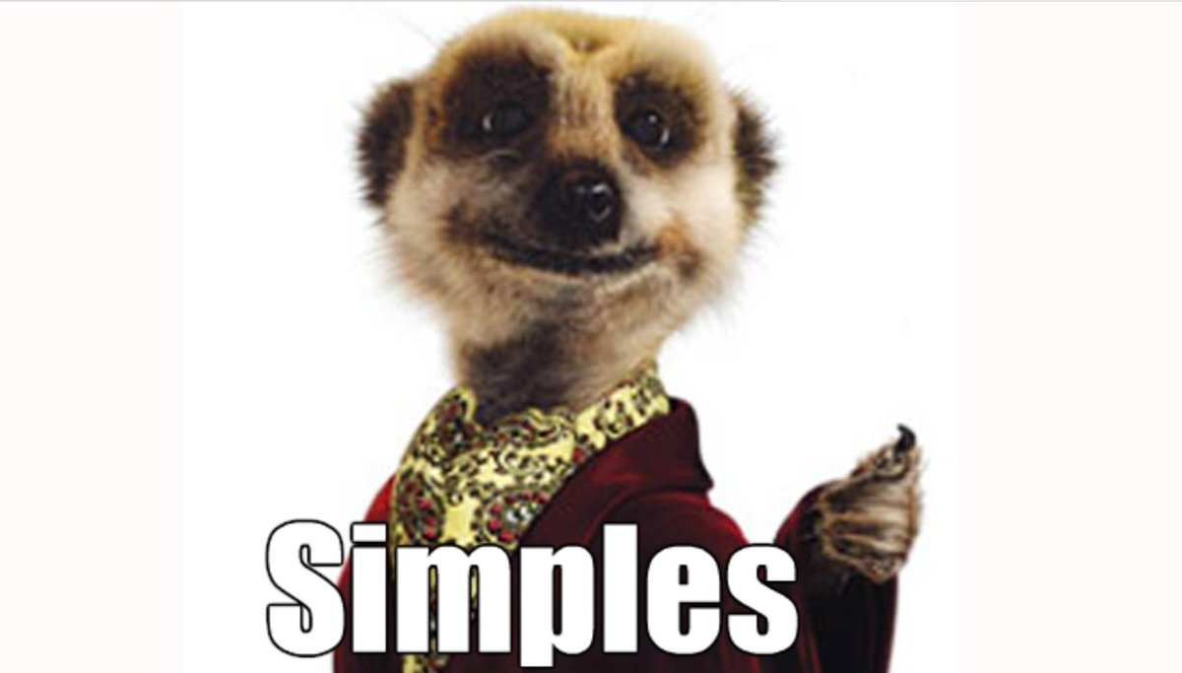

Slide 16
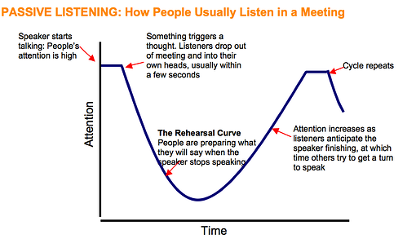

Slide 17
Not in the zone…
Why won’t they listen?
How can they not get it?
Are they actually trying to annoy me?
I could so do without this?

Slide 18
They’re not receptive
I’m not at my best
Emotions
Game playing
Our relationship
Judging
Notes:
Some of the gotchas

Slide 19
Listening Levels (Carol Wilson)
Interrupting
Hijacking
Advising
Active Listening
Attentive Listening
Notes:
Carol Wilson’s listening levels – see handout Listening well.
Encourage the group as a whole to reflect on each of the levels. Impact of each level etc
1 – I’m more interested in what I have to say, and am ‘waiting my turn to speak’ or interrupting
2 – finding connections that you have with their story and adding your bit in... E.g. Oh that’s happened to me too!!! (turning the attention to themselves instead of keeping it on the coachee)
3 – giving advice (the manager’s pitfall) listening for the problem/issue and then creating solutions for the person
4 – paying attention, focusing, asking for more, learning the story and the experience of the coachee, using questions to enhance understanding and pen up the story
5 – intuition, recognising how people talk, voice, speed, emphasis and how they behave with their telling of their story – the gut feeling (there’s something else?, there’s something that doesn’t fit etc)

Slide 20
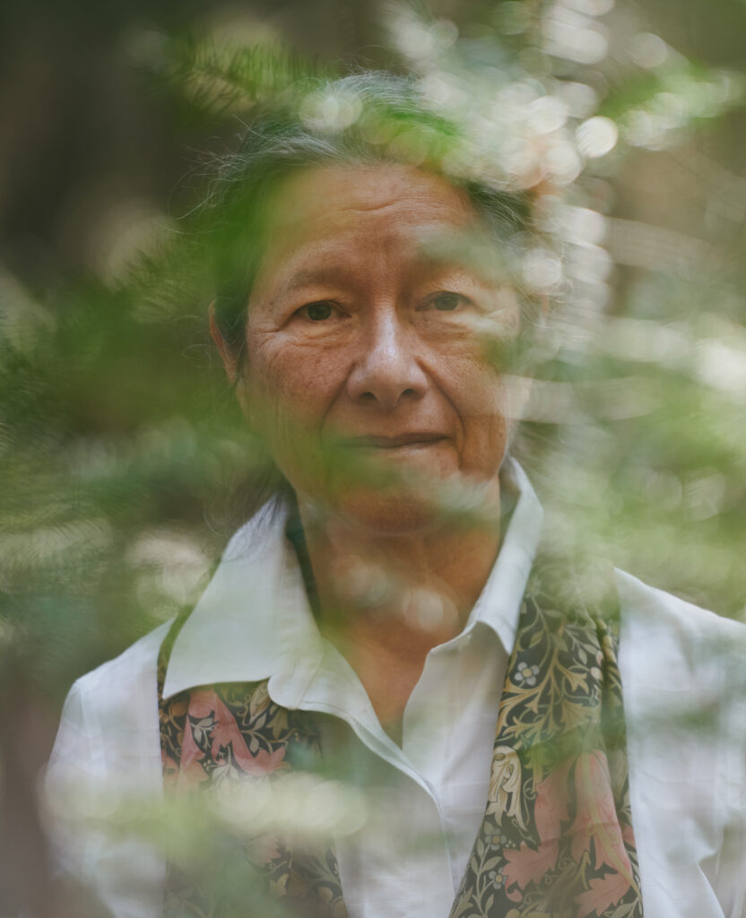
Be present
Said/not said, how do I explore this
Gestures, posture, expression
Words, pace, tone, pitch
Silence
Mirror back, clarify
I notice…
I hear you saying…
I feel there’s something else…
Gut feeling
Notes:
All the non-verbal

Slide 21
On-the-spot-coaching
…is a form of coaching that happens immediately after an event, rather than being scheduled in advance:
Give immediate feedback – or ‘plant the seed’
Focus on behaviour
Explore impacts, consequences
Ask questions to develop and confirm understanding
Notes:
Why might this be particularly powerful?
Recency, done and dusted, best practice, assertive

Slide 22
SPOT also stands for:
You’re ‘opener’ sets the tone
Attentive listening online
Note follow-up converstaions

Slide 23
How to start SPOT
Talk me through… I noticed – what was your approach here? This is a good one to pull some learning from… Let’s unpick this one… Wow, that really worked – why do you think that was? What else…what else… I’d add…

Slide 24
Let’s practice
Something someone is ‘stuck with’
Recent incident
Situation – Opportunity – Timeline
Or something else…

Slide 25
Let’s practice – online triads
1 Leader
2 Colleague
3 Observer
Practice 10min
Debrief 10min
Worked well – less so?
Challenges, distractions?
Holding back?
Applications?

Slide 26
Which approaches would benefit our work?
What’s needed to do this?

Slide 27
Post survey

