Slide 1
EHSCP Long Term Conditions Programme
Future Care Planning
Level 2: ACP Training

Slide 2
Who we are
Edinburgh Health and Social care Partnership's Long Term Conditions Programme
work in partnership with health and social care teams and voluntary organisations who support people living with long term conditions
spread Anticipatory Care Planning (ACP) learning
test improvements, embed ACP in integrated pathways

Slide 3
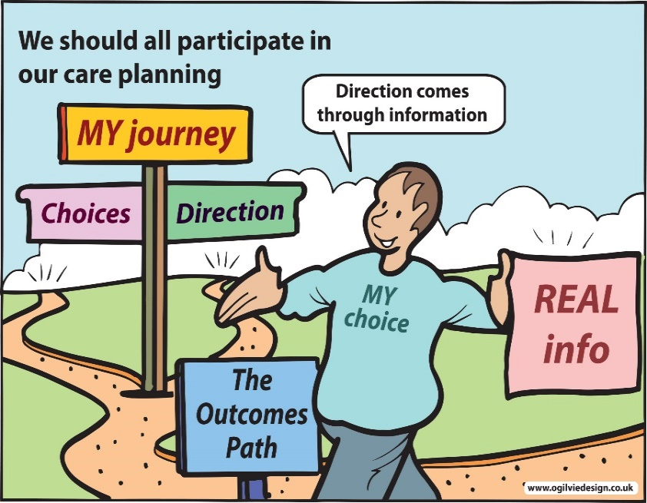
Training content
Learning outcomes
What is ACP?
Why ACP is important?
How to complete an ACP
When to initiate an ACP conversation
How to initiate an ACP conversation
How to have an ACP conversation
Using the updated 7 steps forms
Discuss any challenges with the process of getting a KIS available in the home.

Slide 4
Learning outcomes
Be able to describe what Anticipatory Care Planning is & why ACP is important.
Be confident to initiate, discuss and record an ACP conversation.
Be confident with the using forms in the 7 steps process.

Slide 5
What is ACP?
Anticipatory Care Planning (ACP) means:
having a shared understanding, and then...
thinking and planning ahead, and then…
documenting, sharing, and accessing these plans

Slide 6
Why ACP is important?
Captures a person’s wishes.
Person-centred care.
Helps people get the right treatment.

Slide 7
Who benefits from an ACP?
Anyone with unstable or deteriorating health:
everyone living in a care home.
Notes:
You have mentioned in your needs assessment that it is not always easy to know when to start acp conversations. Liz, do you want to tell me more about this.
Sure.. I know you need to do it as soon as you can but it is not always possible. You have to..sort of… gauge the resident and gauge the family. It needs to be sooner rather than later because there may be emergencies, so you need to know as soon as possible. But some are already anxious and now you are talking to them about, you know, their mother getting seriously ill.
Thanks Liz. I will definitely cover that. Any other situations anyone finds difficult?
It can be very different. One resident had a daughter who was a gp and they were very open to acp, but others are like “are you saying they are going to die?”

Slide 8
Triggers for ACP discussions
“Admission to a care home”
“Multiple NHS24 or A&E contacts”
“unplanned hospital admissions”
“Planned reviews of care plan”
“Frailty screening (eFI Rockwood)
“After Hospital admission”
“Notable decline in function, abilities or general health”
“Significant new diagnosis”
Notes:
Admission to care home is clear trigger for all your residents. Ideally asap but need to have established a reasonable rapport with the resident and/or family. At least by 6w review. However, I want to draw your attention to the other triggers. Once you have an ACP in place the process isn’t over. When things change it needs to be reviewed. Admission, new diagnosis, multiple nhs24 or A&E contacts, or a significant new diagnosis, eg stroke or cancer.

Slide 9
7 Steps to ACP in Care Homes
The process for creating, maintaining and using a high quality ACP/KIS in a care home.

Slide 10
Step 1: preparing residents or relatives for the conversation
Give the resident or relatives/friends the ‘Let’s think ahead’ leaflet.
This helps prepare them for the conversation to come.
Notes:
When to do this? Ideally prior to arrival. In hospital assessment or when families are coming for a look round before admission. Many homes who use 7 steps have got out of the habit of using this leaflet but I would encourage it as it helps reduce the shock of the subject being brought up.

Slide 11
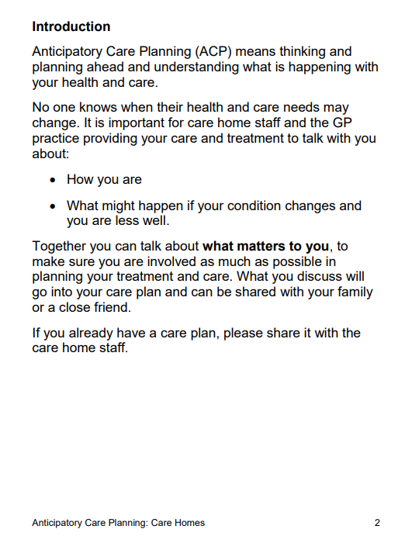
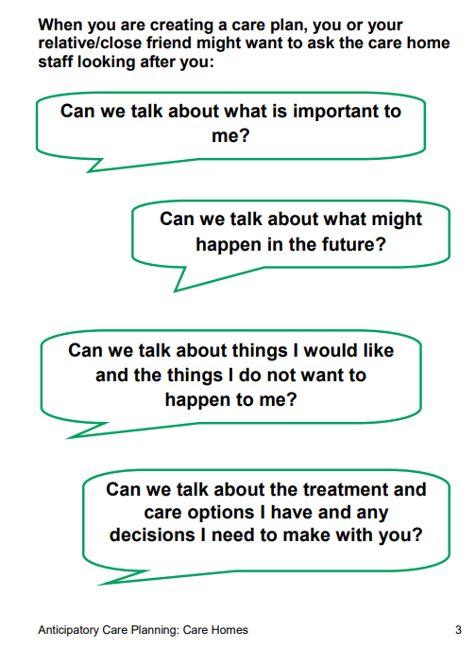

Slide 12
Step 2: preparing yourself for the ACP conversation
Check if they already have an ACP/KIS
Read Document 1 of the 7 steps guide. This gives you guidance on how to phrase the conversation
Notes:
New residents may have comments on d/c letters if from hospital. If from another home ask the staff to transfer ACP information with them.

Slide 13
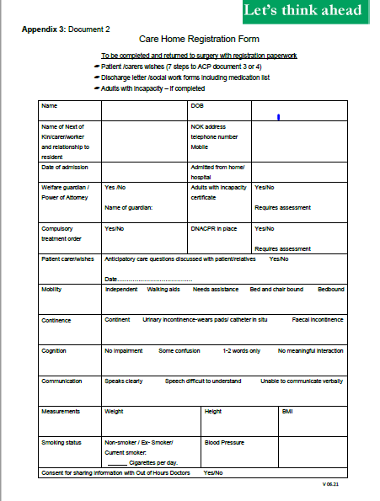
Step 3: complete document 2
Capture the baseline information for your resident.
Record it in Document 2.
Notes:
There are many things that help create a high quality ACP.
What a person is normally like; baseline function.
Who is their next of kin?
Do they have a power of attorney (POA)?
Do they have an Adult With Incapacity Act form (AWI)?
Do they have a DNACPR?
This is all covered in Document 2.
This information is all available when someone first arrives in a care home and the form should be completed on arrival

Slide 14
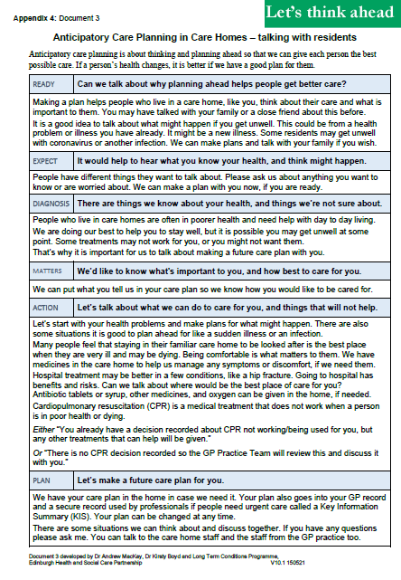
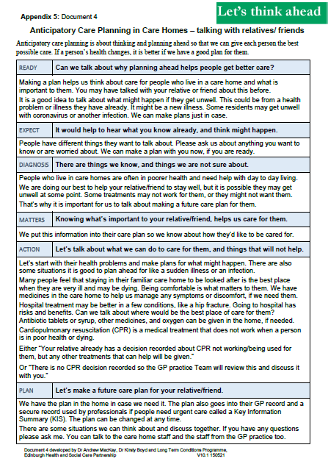
Step 4: complete document 3 or 4
3: talking with residents
or
4: talking with relatives/friends
RED-MAP model to support having good ACP conversations
Ready, Expect, Diagnosis, Matters, Action, Planning
Notes:
This is the area of ACP that some people find daunting but having a good structure for this conversation and resources to guide you makes it a lot easier.
When problems happen in acp conversations it is usually because people jump to making a plan too early. “what do you want to happen when you get ill” should be the second last rather than the first question.
The new versions of documents 3 and 4 have a conversation guide on the first page and I would encourage you to work through that in order.

Slide 15
Are you Ready?
The individual as well as any close family/friends/carer should be included in any discussion.
An appointed POA must be included whenever possible.
Ensure there is adequate time.
Use a leaflet to guide people as to what to expect in the discussion.

Slide 16
What do they Expect?
To create a shared understanding you first need to know what someone thinks.
Notes:
Creating a shared understanding of the current situation is crucial to creating an appropriate ACP. The first step to that is knowing what the person and those that are close to them think of their health at the present and in the future.
What are their thoughts, questions or worries about what might happen?
Is there anything they want to ask about the future?
If the persons expectations seem to be very different from what you understand the situation to be you should be very cautious. You can progress to the next step to try to resolve those misunderstandings, but you need to be careful.

Slide 17
Diagnosis
Create a shared understanding by saying what you know about a person’s health.
…. but be careful!
Notes:
It is here that you establish the shared understanding about a person’s health.
Let’s talk about what you/(person’s name) need(s) help with.
You/(person’s name) seem(s) pretty strong/not as strong as you were/a little frail/pretty frail/very frail at the moment.
You can share your understanding of what you know of their health conditions.
When a person is more frail there are some treatments that may not work for them, or that they might not want. That is why it is important for us to talk about making an ACPIf you get to this stage and you still feel that they or their relatives still have v unrealistic expectations about what the future holds, they think that their time in the home is going to be brief and that they will get back to their own home, or their dancing or cooking lunch for their family in a couple of weeks time, you should stop. This is when to contact the GP and explain that you hadn’t been able to reach a shared understanding and could they have a word with the resident or the family and see if they would have more luck. For the GP, undoing an inappropriate acp is much harder than doing it themselves.
Have any of you had situations like that.
We have a couple of unreaslistic families. We’ve tried to have a conversation with them a couple of times, but as soon as the GP comes to speak to them they are all fine and dandy.
It is not necessarily right but the reality is that if a gp challenges their expectations and says ‘ I don’t think your mother is going to be able to walk again and her dementia is going to continue to progress rapidly’ they are more likely to accept it than if a carer, or even nurse, says the same thing. So it can be really helpful to involve the GP in these situations.

Slide 18
What Matters to them?
What matters to the resident.
Not . . . what matters to the relatives.
Notes:
It is vital that you concentrate on what matters to the resident. When having discussions with other people, such as family/POA etc, you should explain that you want to know their views on what the resident would want. This can be different from what they want for the resident.
Physical independence.
Grand-daughter getting married.
Family wanting interventions for mum, who was exceedingly frail. I asked what they think mum would have wanted and they said. ‘mum also said to shoot her rather than let her go into a care home’ So I said we should maybe have a think about that. They went away and thought about it and when they came back changed everything to much more supportive care.

Slide 19
Action
Many people feel that staying in their familiar care home to be looked after is the best place when they are very ill and may be dying. Being comfortable is what matters to them. We have medicines in the care home to help us manage any symptoms or discomfort, if we need them.
Hospital treatment may be better in a few situations, like a hip fracture. Going to hospital has risks and benefits. We need to think about what would be the best place of care for them.
Antibiotics, sometimes including by injection, and oxygen can be given in the home, if appropriate.
Notes:
These are the sort of phrases we can use. We are not discussing specific plans here just talking generally about what treatments may or may not help.
We need to remember that treatment that is never going to work is harmful.

Slide 20
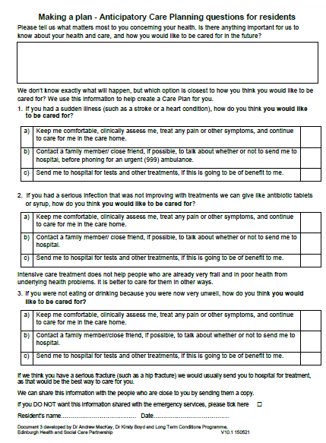
Let’s make a Plan
This is the last step.
Record what matters most.
Use the three questions on page 2 of document 3 or 4.
Notes:
It is only now that you start to discuss the three questions in document 3 or 4, focussing on wishes for future treatment in the event of a sudden collapse or stroke, infection not responding to treatment or an inability to eat and drink due to illness.
Once completed the information is sent to the GP to create secure record used by professionals if people need urgent care, called a Key Information Summary.
This comes right at the end to ensure both you and the person making those choices have a shared idea of the clinical situation and what is important to the resident.

Slide 21
Step 5: acting on an ACP conversation
Make a copy of the completed documents
and file them in the care plan

Slide 22
Step 6: sharing the information
The original documents should be sent to the GP practice.
They will then use the information to create a KIS.
Once completed they should return a paper copy of the KIS to the care home.
Notes:
The decisions on the KIS are the GPs decisions. These are informed by the questionnaires you provide them but the responsibility is all with the GP

Slide 23
Step 7: Get ready to use the ACP
File KIS with DNACPR (where appropriate)
Review regularly:
during reviews with family,
during reviews with GP team,
after significant health events.

Slide 24
ACP resources for practitioners
NHS Lothian Anticipatory Care Planning for Care Homes
7 steps to ACP for Care Homes implementation guide and resources
ACP Community Bundle
Toolkit for preparing, discussing, recording and sharing ACPs
Healthcare Improvement Scotland – ACP Toolkit 2021, SPICT
ihub Future Care Planning (Anticipatory Care Planning) Toolkit
National ACP guidance and resources

Slide 25
Any questions?
Notes:
There can also be a scenario where the next of kin can change their mind. In as much as all the way through an illness process the resident and the next of kin have said ‘no,no,no we want them to be kept comfortable and keep them looked after in the care home. And then they really start to deteriorate and they ask to go to hospital.
Respect their choice. Not legally binding. Can be changed at any point. Can remind them about previous choices but changing their mind is not a failure of the process.
Poa says not for admission but another relative says not to.
KIS plan is view of GP and they are encouraged to involve all appropriate parties in the decision. The view of the POA takes precedence over those of other family members. If there is no POA and there are conflicting views the GP will try to help achieve some sort of agreement. If that is not possible they will decide what they think is the most appropriate view and go with that.
We had a patient who became very unwell with Covid. We called NHS 24 and they were really worried about her low sats and said they would send an ambulance. When we called the family they were like.. No, we want her to be kept comfortable in the care home. This put us in a difficult situation because, you know, the o2 sats were very low.
Many don’t realise call handlers at nhs24 don’t have access to a kis. Their clinicial supervisor does and the call handlers can see there is one, but they can’t access it. So if you have a resident with a KIS that states they are not for admission to hospital in the event of an illness not responding to treatment you need to tell the call handler this. You can explain what the KIS says and then ask to get some clinical advice on how to support the unwell resident in the home.
What if the POA is a solicitor?
These are pretty easy as the solicitor generally says ‘whatever the doctor thinks is the appropriate.’

Slide 26
LongTermConditions@nhslothian.scot.nhs.uk
Notes:
Where to get help? ACP team there to help.
Day to day support from ACP champions.

