Slide 1
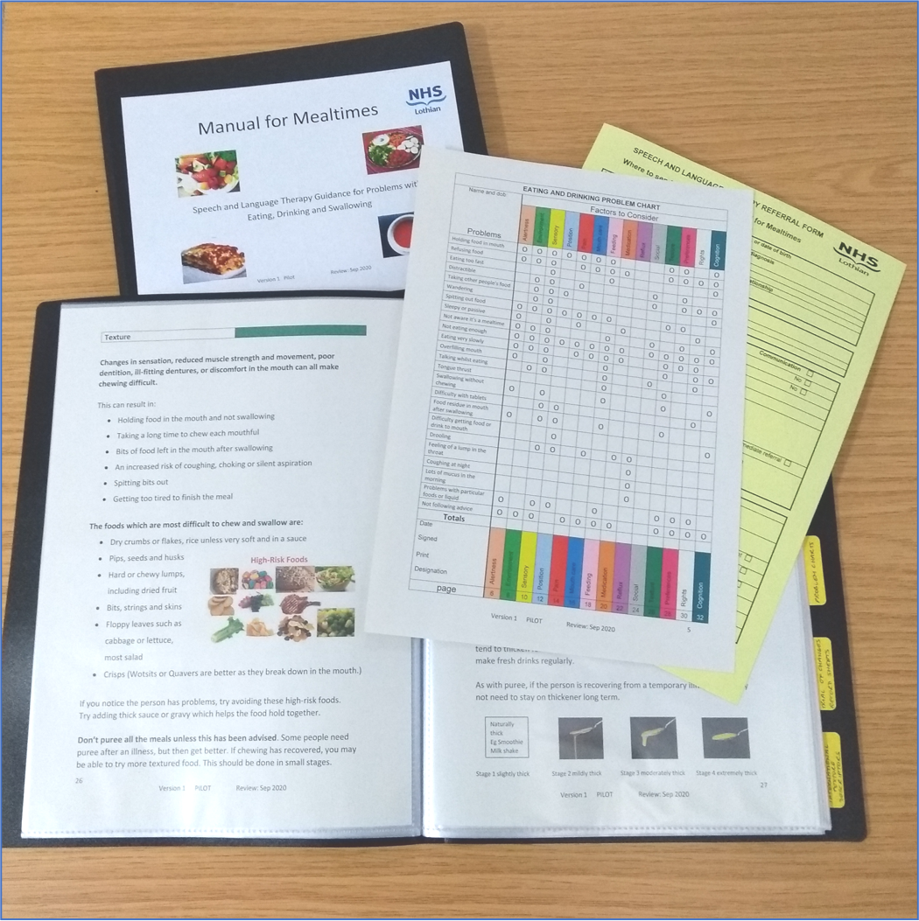
Manual for Mealtimes
Improving the mealtime experience of people in care homes
Who is it for? Health and Social Care Staff
When should I use it? If you notice a problem with a residents eating, drinking and/ or swallowing.
How do I use it? If resident does not meet criteria for an immediate referral (pg.5), then fill out an ‘Eating & Drinking Problem Chart’ (pg.7), to identify areas the resident is having difficulty with. Follow suggested advice and record outcomes on ‘Trial of Changes Record’ (pg.39). Keep careful records and liaise with other staff members to monitor changes. If problems do not resolve refer to SLT using the ‘Referral Form’ (pg.66). These records are sufficient evidence to show the Care Inspectorate.
Why use it? People with Dementia and other conditions may develop difficulties with eating and drinking, especially in the later stages of illness. This manual guides you in supporting residents eating and drinking to help reduce the risk to health from their swallowing difficulties. Not all problems will require intervention from a Speech and Language Therapist. Using this manual will help you to make informed decisions around residents’ mealtime needs.
What is it? A guide to help you support the eating and drinking experience of residents. It will help you to know when a referral may be appropriate and how to refer to Speech and Language Therapy (pg.39). Manual for Mealtimes has been approved by the Care Inspectorate.
NHS Lothian Adult Speech and Language Therapy Service

