Slide 1
Supporting Your Child With Anxiety and Worries
Information for
Parents / Carers
Child and Adolescent Mental Health Service (CAMHS), NHS Lothian

Slide 2
Part 2
Anxiety Traps
Information for
Parents / Carers
Child and Adolescent Mental Health Service (CAMHS), NHS Lothian

Slide 3
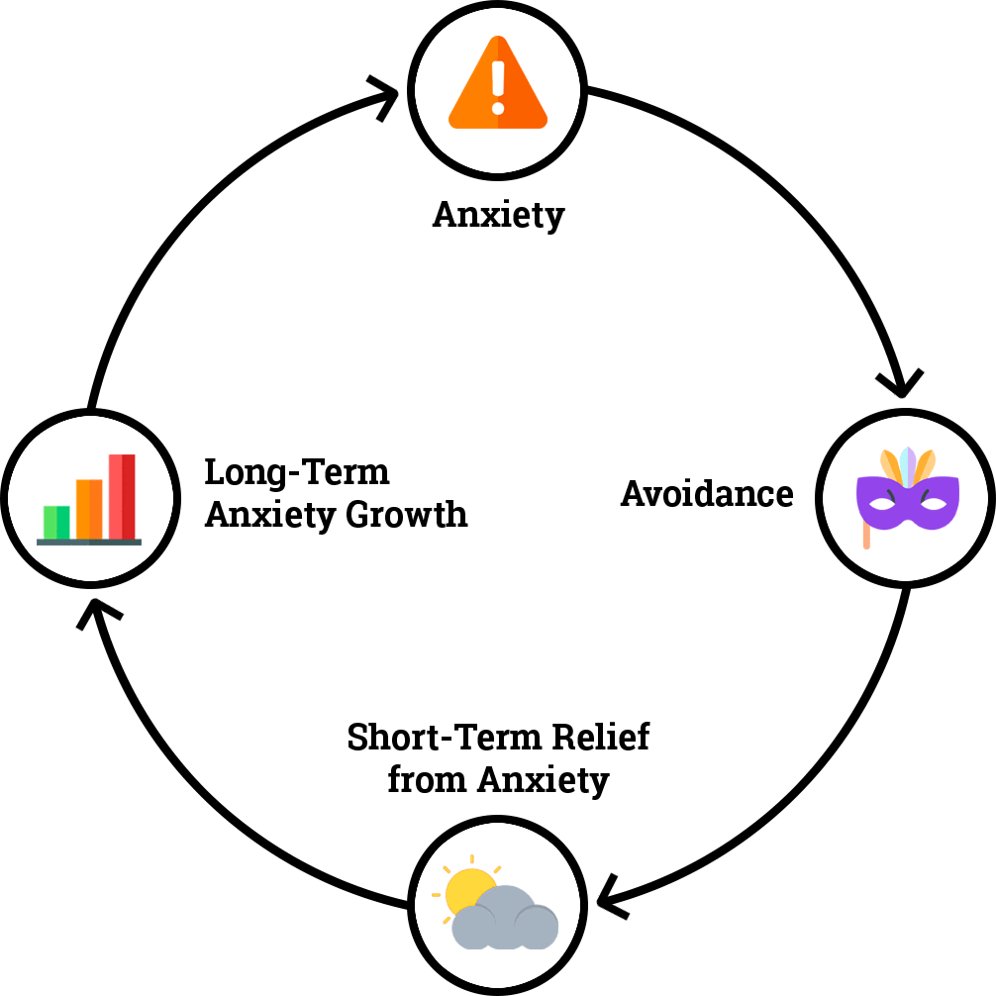
ANXIETY TRAPS
ANXIETY TRAPS
Children and young people who struggle with anxiety, often engage in behaviours to protect themselves against danger or to prevent a feared event. These behaviours can include escaping or avoiding feared situations, seeking reassurance from people around them, or using ‘safety behaviours’. A safety behaviour is any behaviour that your child relies on to be able to go into or stay in a situation that makes them anxious. For example, they go to the park but only if you go with them.
All of these behaviours are known as ‘anxiety traps’. They are traps because they reduce anxiety in the short-term but keep it going in the long-term. If your child is falling into these anxiety traps, you may have noticed that their anxiety has got worse over time or that they have become less confident they can cope.
Yet to overcome anxiety, children and young people need to face feared situations. This helps them learn that:
What they worry about may not happen. There is no actual danger.
What they worry about isn’t as bad as they thought it would be.
Even though they might feel anxious, they are able to cope.
Anxiety naturally reduces when they stay in the situation
As parents/carers you can help your child overcome their anxiety by:
Noticing your child’s anxiety traps
Not unintentionally reinforcing these anxiety traps
Not falling into these anxiety traps yourself
It is easy to be tricked by anxiety and to get stuck in anxiety traps. Please don’t be hard on yourself if you realise that you or your child have fallen into an anxiety trap. There are things you and your child can try to break the vicious cycle of the anxiety.
When children are distressed, they turn to their
parents/carers for comfort and support. As
parents/carers you notice the signs that your child
is upset and understandably want to protect
them and make them feel better. It is hard for
any parent/carer to see their child distressed.
Research tells us that when parents change their responses, it can break an anxiety trap and help reduce the child’s anxiety.
Early Intervention Team, CAMHS, NHS Lothian

Slide 4
ANXIETY TRAPS
COMMON PARENT ANXIETY TRAPS
Reassurance
When children and young people learn something new, they often ask a trusted adult for their feedback. This includes asking questions about potential dangers and safety. It is normal and helpful for adults to provide reassurance and to support children to learn.
Limited amounts of reassurance are normal and can be helpful. It can encourage your child to do something they haven’t done before.
However, children who experience anxiety often seek lots and lots of reassurance and ask the same questions over and over again. Some examples of reassurance seeking are:
“Are you sure you locked the front door?”
“Did you wash your hands before you cooked this?”
“What if I go to the party and am sick in front of everyone…?”
Asking you to check their homework repeatedly
This can be frustrating and time consuming for parents/carers and they can easily get drawn into:
Making promises that things will or won’t happen
Providing examples of when things did or didn’t happen
Telling them that everything will be okay.
Providing lots of reassurance can be unhelpful because:
Your child keeps needing more and more. It’s never enough.
It relieves their worries only in the short-term but doesn’t change or stop them in the long-term
It keeps your conversation and your child focussed on the worry.
It is not about not responding, it is about responding differently by:
Limiting the amount of reassurance you give
Asking your child questions, rather than giving answers
Showing empathy by validating your child’s feeling
Suggesting a more helpful way of coping with their worries and anxiety
You can learn more about reducing lots of reassurance seeking at Anxiety Canada
Early Intervention Team, CAMHS, NHS Lothian

Slide 5
ANXIETY TRAPS
Avoidance and Escape
Let’s think back to the Fight and Flight response. Our brain is designed to alert us to possible threats and dangers and to keep us safe by getting us ready to run away or fight. Avoidance is a natural, instinctual flight response that is common for both children and adults.
As a parent/carer, it is natural that you don’t want to see your child distressed. You want to protect them from situations that make them feel anxious and may therefore unintentionally end up helping them avoid.
However, when we avoid situations we do not have the chance to learn what the situation is really like and that we are able to cope. We are also not able to learn and practice coping strategies that help us to get through situations we find anxiety-provoking.
Some common ways parents/carers unintentionally fall into the avoidance anxiety trap with their child:
Taking on responsibilities that would otherwise fall to the child
Changing family routines so the child doesn’t have to do something
Picking up their child early
Letting their child stay home/not go to things that make them anxious
If the situation is avoided, the child doesn’t learn that they are able to cope and will be just as or more anxious next time.
Thoughts: “I can't cope with this”
Feelings: anxious
Behaviour: avoid situation
Early Intervention Team, CAMHS, NHS Lothian

Slide 6
ANXIETY TRAPS
Safety Behaviours
Safety behaviours are subtle behaviours that your child uses to prevent their fears from coming true or to feel more comfortable in situations they feel anxious about.
Some examples of safety behaviours:
Frequent hand washing or asking parents/carers to wash their hands
Sitting near the door so they can escape if needed
Overpreparing for tests
Taking a soft toy or other object like a water bottle with them
In the short-term these behaviours can help your child to face or get through an anxiety provoking situation. It makes them feel less anxious and appears to reduce their worries.
Why are safety behaviours unhelpful?
When your child uses a safety behaviour and their fears don’t come true, they might believe the safety behaviour ‘prevented’ their fears. Over time your child can become dependent on safety behaviours and feel even more anxious when they can’t use them.
Safety behaviours also stop your child from directly testing their fears and worries will continue to pop up in the future.
As with avoidance, you might unintentionally help your child to use these safety behaviours or become part of their safety behaviour.
Managing Anxiety Traps
To help reduce your child’s anxiety, it is important to identify any anxiety traps you and your child might have fallen into.
This can help you to come up with a more helpful plan for managing your child’s anxiety in feared situations. It may also prevent you from falling into anxiety traps in the future.
What anxiety traps might you be falling into?
Early Intervention Team, CAMHS, NHS Lothian

Slide 7
ANXIETY TRAPS
MAKING A PLAN TO AVOID ANXIETY TRAPS
STEP 1: Make a clear plan
Before you start reducing anxiety traps such as reassurance or avoidance, it is important that you have a clear idea of what you want to do and how you plan to do it.
Think about what specific behaviours you want to change or stop and what you plan to do instead.
For example: I want my child to stop asking me whether I am sure I locked the front door at night. I won’t provide reassurance when they ask me. I will remind them that providing reassurance keeps anxiety going and ask them to use a coping strategy instead (deep breathing, a coping statement, a relaxing activity). I will praise them for trying something new.
Write down your plan::
STEP 2: Discuss the plan
Discuss your plan with other important adults in your child’s life and get them on board so you all respond in the same way. Ask if they have any suggestions to add to the plan.
Discuss your final plan with your child. Make sure they understand the plan and its purpose.
How will I explain the plan to my child
Early Intervention Team, CAMHS, NHS Lothian

Slide 8
ANXIETY TRAPS
STEP 3: Follow through with the plan
Once you have explained the new plan to your child and checked they understand what is going to change, it is important to consistently follow through with it.
It can be tricky at first to change our behaviours, especially if we have been doing them for a long time.
You might need to remind yourself and your child of the plan at first but it will get easier over time as they learn that they can manage their anxiety.
You might also find that your child becomes very anxious when you first start changing how you are behaving. They might also become very frustrated or angry. If you stick with it however, they will break the anxiety traps and you will support them to learn how to cope with their anxiety in helpful ways.
STEP 4: Praise and positive attention
It might feel like a big change for your child at first and they might need to work very hard to stick to the new plan.
Whenever you notice something your child is doing well, give them lots of praise and draw attention to what you think they have done well or the progress they have made. It helps them to learn what to do more of if you are very specific about what you think they have done well.
I’m so proud of how you went to football practice even though you were worried about it before
Look how well you thought that problem through and worked out the answer by yourself
You are doing such a great job using calm breathing to cope with your anxious feelings
Early Intervention Team, CAMHS, NHS Lothian

Slide 9
ANXIETY TRAPS
HELPFUL TIPS
Be consistent:
The most effective way of overcoming anxiety is sticking to the personalised plan you have made, and being consistent with this approach across different situations, even when it becomes more challenging!
Often when children cry, shout or delay a task that needs to be done (such as going to school), parents/carers switch back to how they were behaving before. While this might work in the short-term it is the same anxiety trap. It also means that children learn that if they cry, shout or delay the task that this will make you give them reassurance or that they can avoid what they are anxious about. This means that they will be more likely to behave like this in the future and it does not help them to learn to manage their own anxiety.
If you stick with the plan then your child will learn other ways to cope with anxiety.
Make sure everyone acts in the same way:
Similarly, it is important to include adults and older children in the house in the plan to ensure a consistent approach. This is to make sure that others are not accidently falling into the anxiety traps, for example, by providing reassurance or helping the child to avoid situations. If you change your behaviour, it may be more likely your child may look to others for short-term relief from anxiety symptoms, e.g. seeking reassurance.
If everyone acts in the same way it is easier for your child to understand the plan and learn how to cope with anxiety.
Give lots of praise and attention to coping skills:
When your child feels anxious, encourage them to use their
coping skills rather than trying to distract them.
Once they have tried out a coping skill or have calmed down, it is important to reinforce this behaviour with lots of praise, attention, and rewards.
Early Intervention Team, CAMHS, NHS Lothian

Slide 10
MANAGING YOUR OWN RESPONSES
ANXIETY TRAPS
Children learn by watching how others react and manage situations. This means we need to be aware of what our children are learning from adults around them.
Research has shown that even if you are the calmest, most relaxed person and parent if you are looking after an anxious child, it is very likely you will start feeling anxious too. As a parent it is our job to protect our children and seeing them upset is understandably very difficult. It makes sense that sometimes we will do anything to help them feel better. However, as we have just seen, avoidance is one of the biggest anxiety traps.
Research also tells us that children who are anxious are more likely to pick up on other people’s reactions than those who are not. They are more on the lookout for signs that there is something to worry about.
Sometimes our responses unintentionally send messages that there is something to be worried about. This can make anxiety worse.
How adults react can break the anxiety trap and reduce anxiety.
It is important to be understanding and caring, but do not let the anxiety trick you into thinking that something is too hard for your child. For example, thinking it's too hard for your child to sleep alone. Yes, it might be challenging, but it can be done!
COMMON RESPONSES THAT CAN KEEP ANXIETY GOING
Adults stepping in and taking over
Avoiding or leaving situations
A child hearing about adult worries
Worried facial expressions
Checking if they are ok lots
How adults cope with their own anxiety
Adult responses can unintentionally send messages that a child is not OK, can’t cope or there is something to be worried about.
When a child’s anxiety gets bigger, adults want to do more to help them feel better and protect them.
If adults change their responses it can help break the anxiety trap.
Early Intervention Team, CAMHS, NHS Lothian

Slide 11
ANXIETY TRAPS
MODELLING YOUR RESPONSES
Children learn from the behaviours of others. They learn how to recognise, show and cope with emotions from the way their parents and carers do.
It is ok to feel anxious yourself, after all we know everybody feels anxious from time to time. Feeling anxious can give opportunity to demonstrate or model to your child how to manage the feeling.
Show your child how you cope with anxiety. Remember, feeling anxiety sometimes is normal. Show your child when you are facing a situation that makes you feel anxious. Show them that you feel it and can cope with it.
“I feel worried about my job interview today, but I will take some deep breaths and do my best.”
Other tips for modelling:
We all have things we worry about or are scared of but if we frequently talk about our own worries in detail it might give a child the idea that they need to be scared too. Naturally being able to predict possible threats is an important survival skill, but try to avoid doing this all the time. For example, saying out loud “I hope there won’t be scary dogs at the park.” Try to send positive messages about coping.
Think about what your body is saying. Even if you are keeping your worries inside make sure your facial expression isn't saying something different. Try to use an encouraging and neutral facial expressions when possible. We know this is not always easy, especially if you are not feeling this inside.
Be aware of conversations that are had around your child, some topics can actually add to fears, rather than reduce it. Hearing about adult worries can increase anxiety in a child. Try to limit what scary or upsetting information your child gets from the news, TV or games they might find scary. This might mean not having some conversations in front of your child. Little ears can be very sensitive!
Demonstrate having a go and confident behaviour –
even if inside you are feeling unsure.
Early Intervention Team, CAMHS, NHS Lothian

Slide 12
MANAGING YOUR OWN RESPONSES
ANXIETY TRAPS
What makes you anxious? What are your tell-tale signs? You could ask a friend or family member how they know you are anxious.
How do you cope with anxiety? Does your child know this?
What does this tell them?
Is there anything you might try differently?
What messages do you or other adults send to your child about their anxiety?
Worried Faces
Sharing worries about how they will cope
Checking they are ok too much
Sharing adult worries (e.g. money, arguments or health)
Helping them avoid
Helping them leave/escape
Seeing too much news
Seeing scary films, TV or games
Early Intervention Team, CAMHS, NHS Lothian

